Slide 1
The Fall of Granada
Religion, Challenge, and Change
Dr Kristie Patricia Flannery, ACU

Slide 2
Lecture Outline
What happened in 1492? The Fall of Granada and the Reconquista
State attacks on Religious Traditions
  The Destruction of sacred buildings
  The Persecution of individuals
Responding to crisis: exile, conversion, secret observances

Slide 3
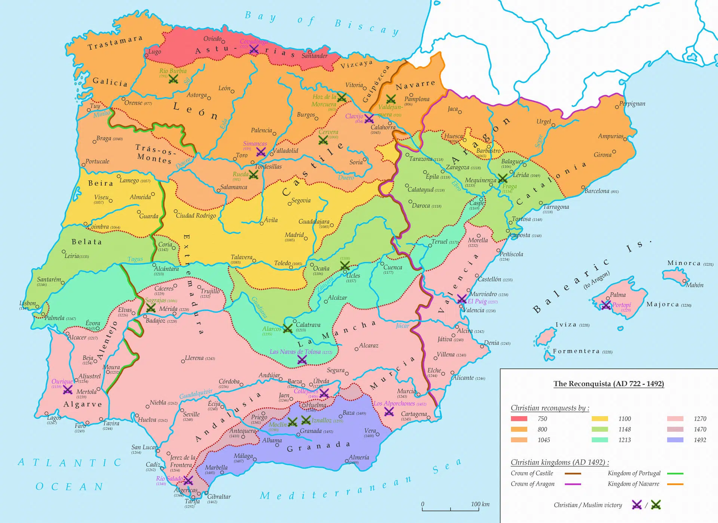
Notes:
https://mapasmilhaud.com/mapas-historicos/mapa-de-la-reconquista-722-1492/
In 711, a Muslim force from North Africa crossed the Strait of Gibraltar and defeated the Visigothic king Rodrigo at the Battle of Guadalete. Within a few years, most of the Iberian peninsula fell under Muslim control, which the Arabs called Al-Andalus.
The Reconquista was a centuries-long religious and military campaign (roughly 718–1492) that saw Catholic kingdoms in the Iberian Peninsula gradually "reconquer" territories that were under Islamic rule. The Reconquista culminated in the Catholic monarchs' Ferdinand II of Aragon and and Isabella I of Castille’s 1492 conquest of Granada, which was the last Muslim emirate on the Iberian peninsula at that time.
I would flag that it was difficult to be Jewish or Muslim in many parts of the Iberian peninsula before 1492. There was a long history of violence by mob violence against themse groups - eg the forced conversions of the Jews in Spain that occurred in 1391. There is a rosy story of convivencia or living together that I think is exaggerated, but for sure intolerance and violence ramps up after the fall of granada.
What we know as Spain today was in 1492 composed of multiple kingdoms, the two largest – Aragon and Castille – unified when Ferdinand II of Aragon and and Isabella I of Castille married. They were known in their lifetime as the reyes católocos or catholic monarchs because of their commitment to spreading Catholicism

Slide 4
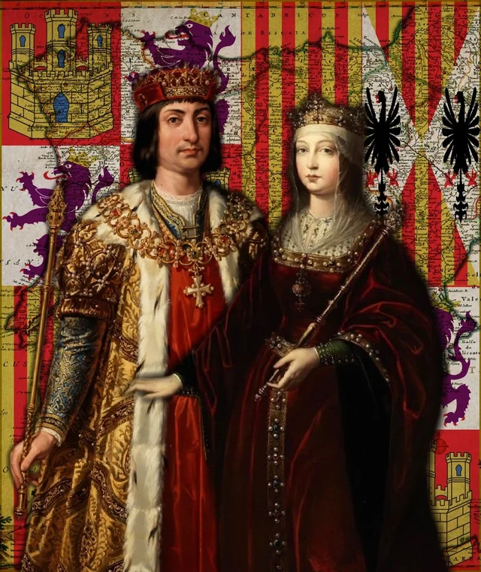
What is the Reconquista?
The Reconquista was a centuries-long religious and military campaign (roughly 718–1492) that saw Catholic kingdoms in the Iberian Peninsula gradually "reconquer" territories under Islamic rule. The Reconquista culminated in the fall of Granada to Ferdinand and Isabella. The Reconquista ended when the Catholic monarchs captured of the city of Granada, the last Muslim emirate on the Iberian peninsula
"The Catholic Monarchs,” Ferdinand II of Aragon and Isabella I of Castile, were champions of the Reconquista
Notes:
To understand the fall of Granda, we need to understand the reconquista (literally translates to reconquest).
In 711, a Muslim force from North Africa crossed the Strait of Gibraltar and defeated the Visigothic king Rodrigo at the Battle of Guadalete. Within a few years, most of the Iberian peninsula fell under Muslim control, which the Arabs called Al-Andalus.
The Reconquista was a centuries-long religious and military campaign (roughly 718–1492) that saw Catholic kingdoms in the Iberian Peninsula gradually "reconquer" territories that were under Islamic rule. The Reconquista culminated in the Catholic monarchs' Ferdinand II of Aragon and and Isabella I of Castille’s 1492 conquest of Granada, which was the last Muslim emirate on the Iberian peninsula at that time.
I would flag that it was difficult to be Jewish or Muslim in many parts of the Iberian peninsula before 1492. There was a long history of violence by mob violence against these groups - eg the forced conversions of the Jews in Spain that occurred in 1391. There is a rosy story of convivencia or living together that I think is exaggerated, but for sure intolerance and violence ramps up after the fall of granada.
What we know as Spain today was in 1492 composed of multiple kingdoms, the two largest – Aragon and Castille – unified when Ferdinand II of Aragon and and Isabella I of Castille married. They were known in their lifetime as the reyes católocos or catholic monarchs because of their commitment to spreading Catholicism #slide, see portrait.

Slide 5
Exile, (coerced) conversions, and secret observances
State Repression
1492 Alhambra Decree (Edict of Expulsion)
1609 Expulsion of Moriscos
Responses:
Exile
Conversion
secret observances
Notes:
Link to english translation of the Alhambra Decree https://www.fau.edu/artsandletters/pjhr/chhre/pdf/hh-alhambra-1492-english.pdf
The Fall of Granada was a watershed moment for the Muslims and Jews who lived in the Iberian Peninsula. With greater power and a larger kingdom, the Catholic Monarchs saw themselves as the rulers of a Christian nation, one that was incompatible with religious plurality. They adopted several measures intended to eliminate Judaism and Islam from the territories they governed. We can understand this event – the fall of granada – as a significant challenge to these religious traditions. (‘Significant challenge’ feels like such an understatement, a total crisis would be more apt).
The state suppression of the Jewish tradition came quickly.
In March 1492, the Catholic monarchs issued the Alhambra Decree, also known as the Edict of Expulsion, that ordered the expulsion of all Jews from the territories Ferdinand and Isabella governed. (Note I have included a link to an english translation of the decree in the speaker notes on my slides).
Effectively, this meant that Jews had to choose either to convert to Catholicism, becoming baptized catholics, OR to leave Spain.
I might pause here and comment on terms. I see that the VCE Study Design document asks teachers and students to understand how a tradition responded to a crisis - I find it interesting and problematic that they use this totalizing, homogenizing language. In the late 15th century, as is the case today, many different people belonged to the Jewish and Islamic traditions, and individual and collective responses to this crisis varied from person to person, family to family, and also varied by place.
As we look at how traditions responded to this crisis that was the fall of Grenada, it is necessary to recognize that there was not a singular, homogenous response.
Primary sources to study the expulsion of moriscos (some materials in spanish, you can use google translate or claude AI to translate: https://www.cultura.gob.es/archivos-aca/en/actividades/documentos-para-la-historia-de-europa/moriscos.html

Slide 6
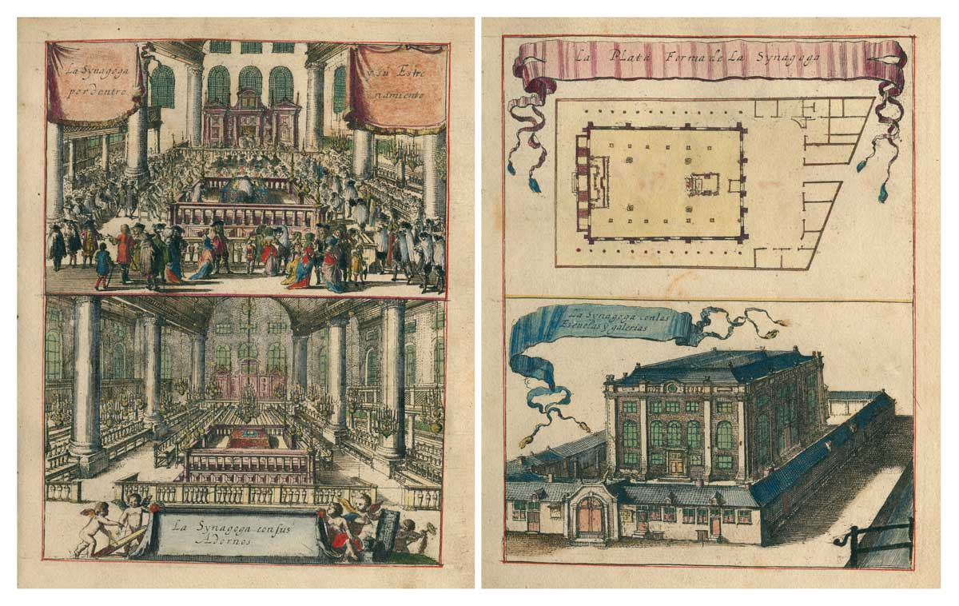
The Portuguese synagogue in Amsterdam (1675)
Notes:
https://jewish-heritage-europe.eu/2025/09/10/netherlands-king/
https://deanderekaart.amsterdam/en/map/POR01-festive-album
Exile
The Fall of Granada created a wave of refugees as many chose exile rather than conversion. Many of those who refused to convert, and had liquid assets, moved to Portugal.
So how many Jewish people went into exile? Historians disagree about exact numbers. Henry Kamen estimated that between 40,000 to 50,000 Jewish people left Spain after the Alhambra decree was issued. But some put this number much higher, closer to 200k
Portugal offered only temporary refuge to Jewish refugees. In 1496, King Manuel I of Portugal decreed that all Jews must convert to Catholicism or leave the country (a decision influenced by his desire to marry the daughter of the Catholic Monarchs, Isabella II).
Practicing Jews and Muslims and people with Jewish or Muslim ancestry were prohibited under Spanish law from migrating to Spain’s new American colonies, but this did not some people from these traditions crossing the Atlantic and making lives in the new world, albeit not in large numbers.
Later, in the seventeenth century, we see the rise of a significant Jewish community in Amsterdam, which became a place of refuge for Jews fleeing Spain and Portugal. #slide
For Muslims, the fall of Granada initially accompanied by relatively generous terms of surrender.
The Treaty of Granada promised Muslims in the conquered city the right to practice their religion, to keep their language and customs, and to be governed according to their own laws. Influential men like the first archbishop of Granada, Hernando de Talavera, thought that this approach would contribute to the success of Catholic missionary efforts to persuade Granada’s Muslims to embrace Catholicism - even Spanish tolerance was based on a desire or intention to make Muslims Catholics, rather than mutual respect.
But this arrangement did not last long. By 1499, a new Cardinal Francisco Jiménez de Cisneros, started conducting mass forced conversions, pressuring Muslim elites to convert, and burning Arabic manuscripts. This provoked a Muslim uprising in the Albaicín quarter of Granada that year, and rebellions in the Alpujarras mountains in 1500 and 1501. The Catholic monarchs brutally suppressed these revolts, and used them as a justification to void the original surrender terms.
At the beginning of the 17th century, one hundred years after the fall of Granada, the Spanish monarchy expelled the moriscos from Spain - moriscos were Muslims who had converted to Catholicism and their descendents. Because this expulsion occurred so long after the fall of granada, I won’t talk more about this today, but I encourage you to read about it.
Let’s come back to 1492. Jews and Muslims who chose to remain in Spain after the fall of Granada had little choice but to become Christians, at least outwardly.
Terminology: Those who converted from Judaism were called conversos. Those who converted from Islam were called Moriscos.
Importantly, among those conversos and moriscos who remained in Spain, many chose to continue to secretly observe their Jewish and Muslim faith and traditions.
But before I talk about this mode of resistance, I want to further discuss the dimensions of the religious crisis that was the fall of granada.

Slide 7
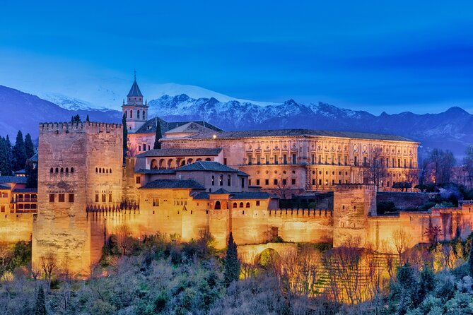
Back to Granada
The Alhambra

Slide 8
Destruction of sacred buildings

Slide 9
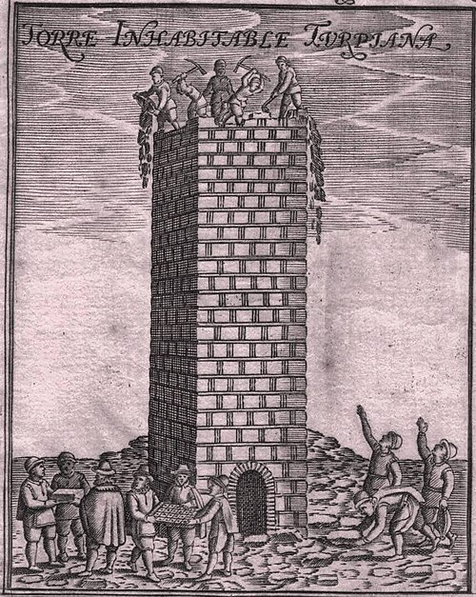
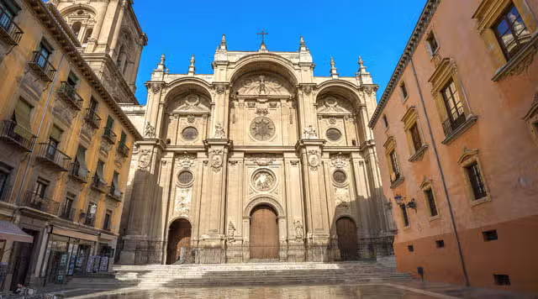
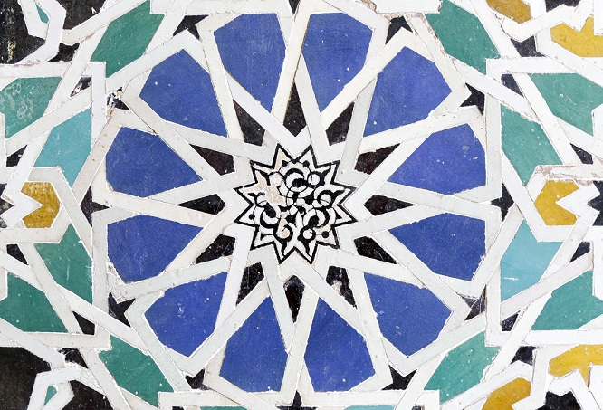
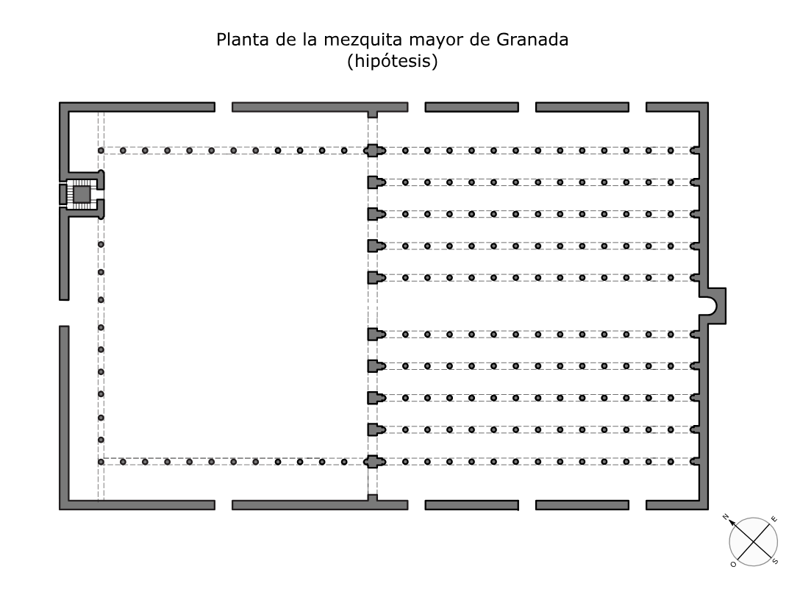
Notes:
Transformation of urban space. The Grand Mosque of Granada was repurposed and then destroyed after the fall of the city.
The Transformation of Space
The Fall of Granada ushered in a transformation of urban space. The Catholic monarchs and the Catholic church ordered mosques be transformed into Catholic churches, or destroyed. Abolishing mosques can be understood as a practical strategy of suffocating Islam in the territories where the Catholic monarchs were sovereign, as well as a powerful, symbolic move that asserted the special place or dominance of Catholicism in Spanish cities.
Let's look at two examples:
The Great Mosque of Granada #slide
Granada was a vibrant urban Islamic center In the late 15th century. The city’s grand mosque was the largest and most important mosque in the city. Other institutions and buildings, including the madraza or Islamic university, and a market, developed around the grand mosque.
What did the building look like? There are no surviving images of the mosque, but surviving floor plans show that the mosque was a rectangular building approximately 36 by 40 m. It featured at least 100 internal columns, and was covered in painted tiles, and featured intricately-carved wood doors. The mosque also featured a patio – outdoor area– with a fountain fed by a deep well for ablution (ritual washing before prayer).
So what happened to the grand mosque after the conquest or fall of granada?
First, the Mosque was repurposed as a cathedral, by 1505 if not earlier. IE transformed from a Muslim house of prayer to a Catholic house of prayer.
Later, the building was demolished and a new cathedral was rebuilt on the site. The old minaret (alminar) of the mosque (seen on slide) was torn down in 1588.

Slide 10
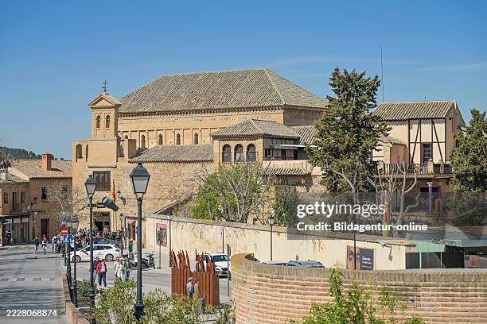
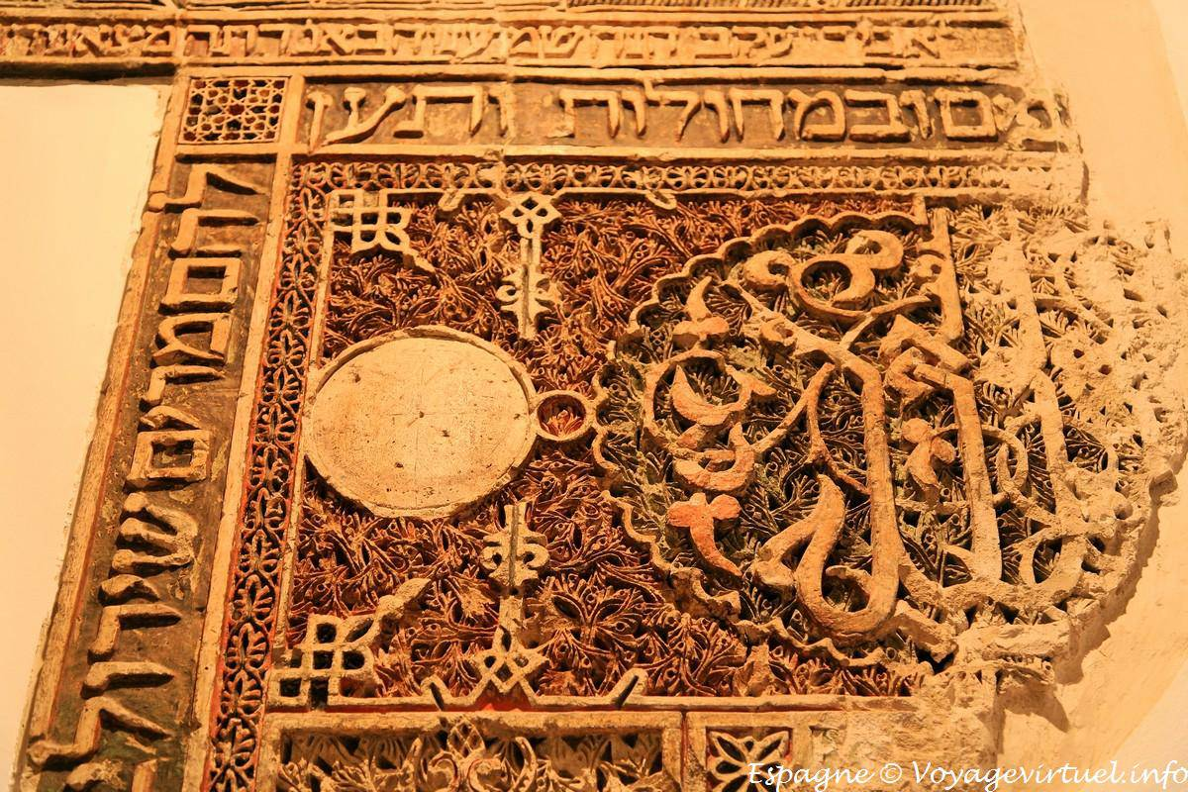
The Synagogue of El Tránsito, or Samuel Halevi’s Synagogue, Cordoba
Notes:
https://dbs.anumuseum.org.il/skn/en/c6/e23554818/%D7%90%D7%95%D7%93%D7%95%D7%AA/_El_Transito_Synagogue_in_Toledo_Spain?utm_source=google&utm_medium=cpc&utm_term=&utm_campaign=x&device=c&gad_source=1&gad_campaignid=22833031659&gbraid=0AAAAADqCky1C3Fz2xpZOxMP0DKcVhuAdY&gclid=CjwKCAiAncvMBhBEEiwA9GU_fr1-fTESkxeP7OuwF_GNfk6JMaUkrXNhobnNxzB58rqA60mlG6n8ChoC8ecQAvD_BwE
(#slide) Synagogues suffered a similar fate. Following the Alhambra Decree that ordered the expulsion of Jews from Castile and Aragon, synagogues in Spain were closed, confiscated by the Crown, and in many cases, converted into churches or hospitals.
One example is the Synagogue of Samuel Halevi which was built in Toledo in the 14th century. Halevi was a rich and powerful man – treasurer to the king of Castile. Located in Toledo's medieval Jewish quarter, the synagogue was connected to Samuel’ house by a gate and was intended as a private house of worship. The complex also served as a center for Jewish religious education or yeshiva.
With the apparent approval of the king, this synagogue defied Spanish laws that required synagogues to be smaller and lower than churches and plain in decoration. It was large – the prayer hall had a 12-meter-high ceiling and featured beautiful Nasrid-style arches. It also has Hebrew inscriptions praising the king and Samuel and Arabic inscriptions and quotations from Psalms. Women were separated from men during services, with a second-floor gallery reserved for them.
In 1492 the catholic monarchs gifted the church to a Catholic missionary order.
What happened in 1492 with sacred buildings was not completely new or exceptional. The long reconquista set precedents for abolishing mosques.

Slide 11
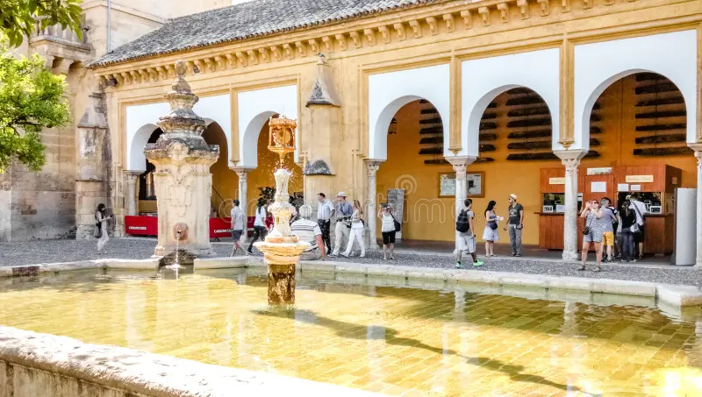
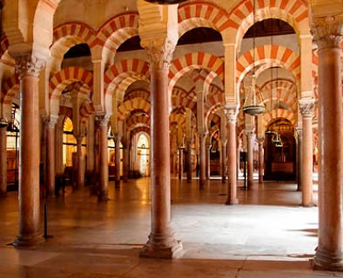
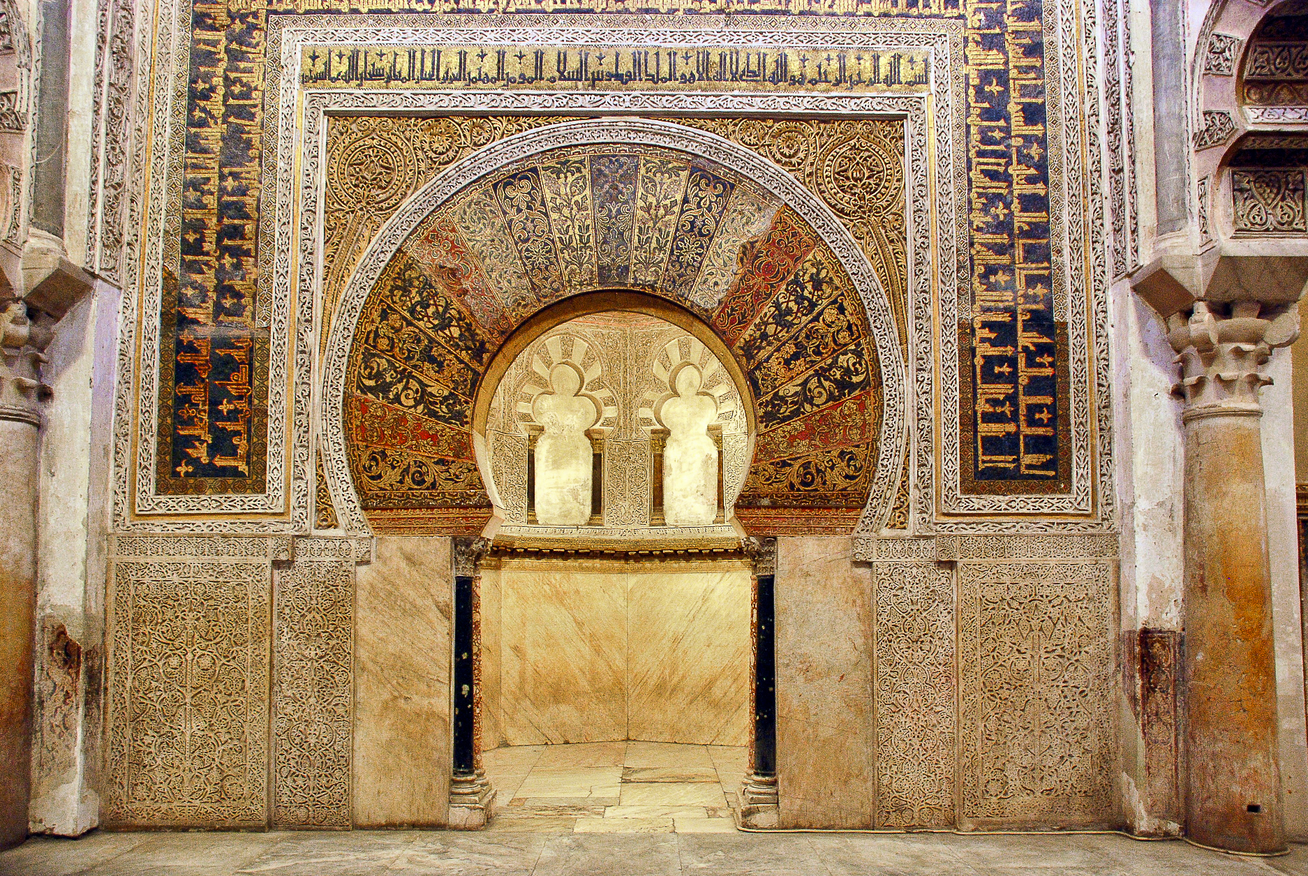
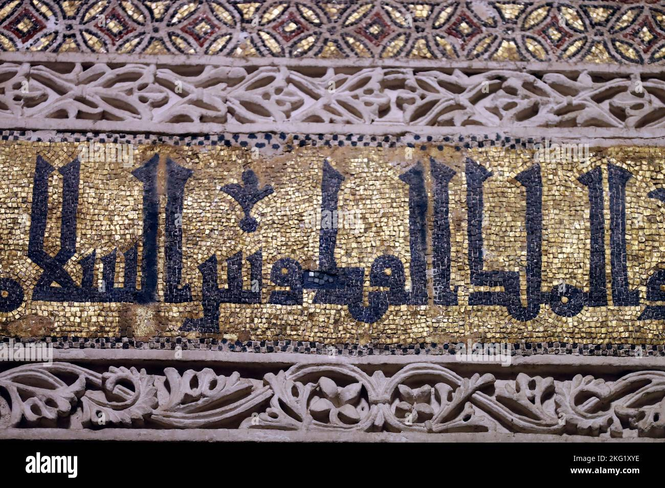
The Mosque/ Cathedral of Cordoba
Notes:
Further Reading
https://whc.unesco.org/en/list/313/
Martínez Capdevila, P. (2023). Representing the unrepresentable: the Mosque of Córdoba and the ideal Islamic temple. The Journal of Architecture, 28(8), 1409–1441. https://doi.org/10.1080/13602365.2023.2301656
Cordoba had been a very important political center in medieval Spain. The construction of Cordoba’s Great Mosque began in 785. This coincides with what UNESCO described as “Cordoba’s period of greatest glory [which] began in the 8th century after the Moorish conquest, when some 300 mosques and innumerable palaces and public buildings were built to rival the splendors of Constantinople, Damascus and Baghdad.” But the great mosque stands out - it was one largest sacred buildings in the Islamic world.
In 1236 the mosque was converted to a cathedral after the Christian forces of Castile captured the city during the Reconquista.
What is fascinating is that this building retained much of its original Islamic features.
Patio de los naranjos - fountains - for ritual washing before prayer
Famous arches - typical of style that developed in Islamic centers
The Mihrab - The famous horseshoe arched prayer niche used to identify the wall that faces Mecca is a practical feature of mosques as Muslims must face toward Mecca during their daily prayers. The mihrab in the Great Mosque of Córdoba is framed by an exquisitely decorated arch, and features original 10th-century Islamic calligraphy.
These features left in tact, but converted into a cathedral with catholic altar
DISCUSSION
What is the importance of a mosque to practicing Muslims? What role do synagogue’s play in Jewish life? What would be the impact or consequences on a religious tradition if these institutions were destroyed?

Slide 12
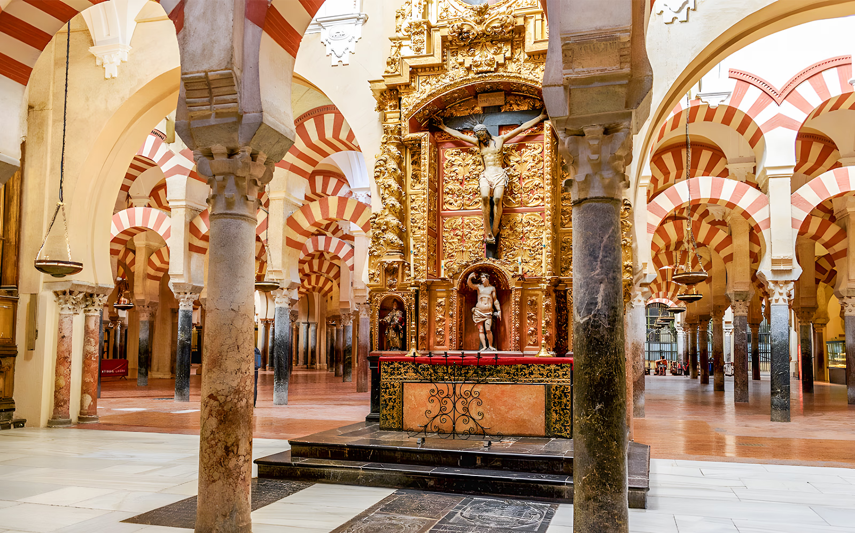

Slide 13
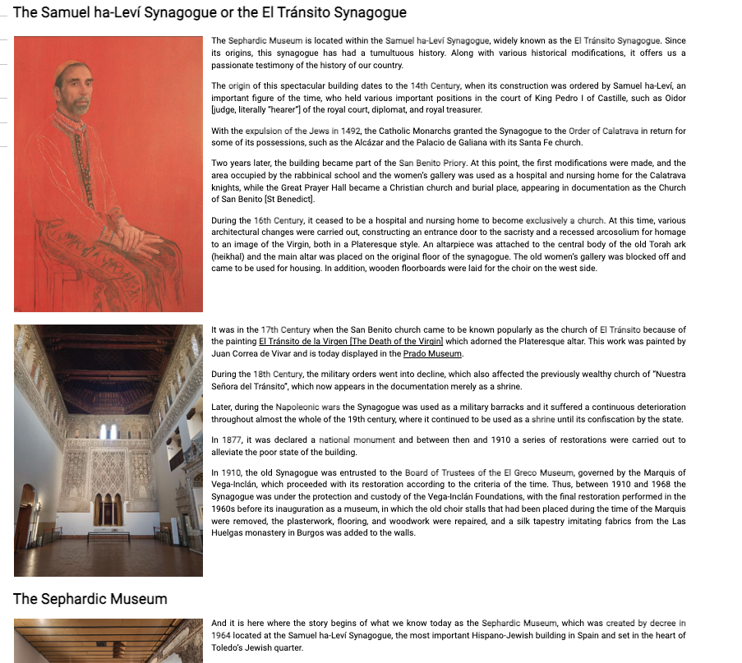
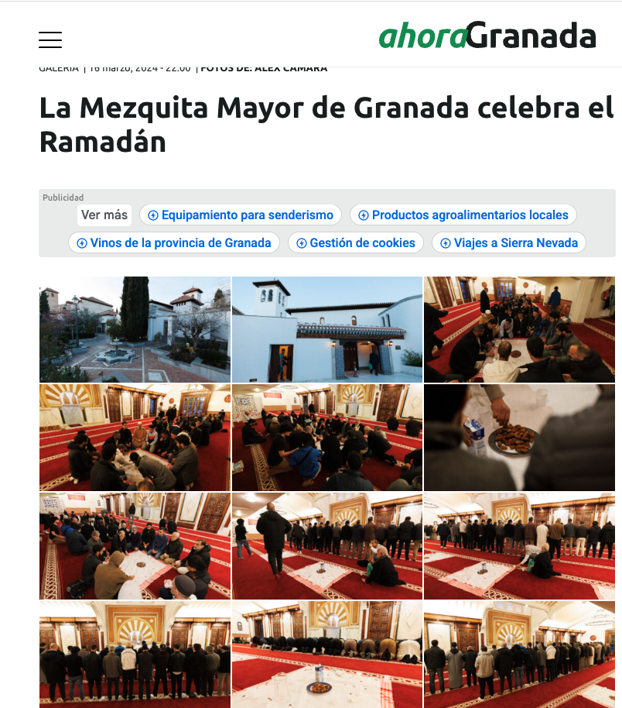
Reclaiming space, recovering and honouring lost histories
Notes:
Sephardic Museum in Toledo: https://www.cultura.gob.es/msefardi/en/colecciones/historia-colecciones.html
Newspaper article about Ramadan in Granada’s Mezquita Mayor/ Grand mosque https://www.ahoragranada.com/galerias/la-mezquita-mayor-de-granada-celebra-el-ramadan/
***
Thoughts on resilience - the long view
In recent decades there have been significant developments in how these buildings are understood
In 1970 the Toledo synagogue became the National Museum of Judeo-Spanish Art, a state institution under the control of the Spanish Ministry of Education and Culture.
The Cordoba Mosque is a UNESCO world heritage site, although still a consecrated church, the building’s hybrid Islamic and Chrisitan heritage is celebrated in the on-site museum and its official website…
New mosque was built in Granada in 2023

Slide 14
Persecution of individuals

Slide 15
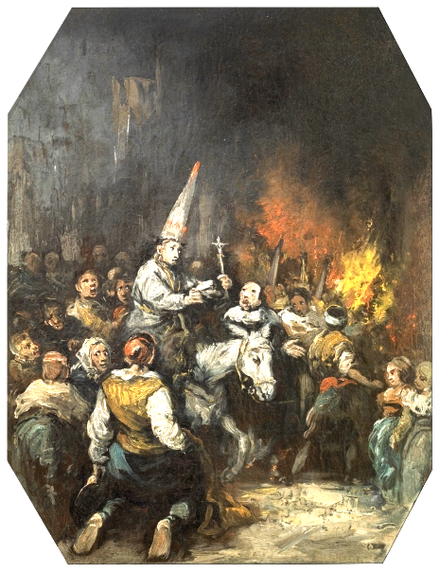
Policing Assimilation:
The Spanish Inquisition
Established in 1478, abolished 1834
Medieval precedents
Jurisdiction over baptised Catholics
Man condemned by the Inquisition
1860. Oil on canvas. Prado, Spain
Notes:
https://www.museodelprado.es/en/the-collection/art-work/man-condemned-by-the-inquisition/b3bd42d3-1d1c-45b4-8754-791e58036338
The Persecution of individuals
Inquisition
The Spanish Inquisition was established in 1478 by the Catholic Monarchs Ferdinand and Isabella, beginning operations in 1480. The Inquisition had a long life, operating until the first decades of the 19th century.
The Inquisition’s primary aim was to maintain Catholic orthodoxy or doctrinal purity by eliminating heresy within Spain, and eventually its overseas colonies.
Eliminating heresy involved identifying and dealing with heretics – ie individual people who held and spread heretical ideas and practices, AND through censoring heretical ideas in printed texts.
The Inquisition evolved to be a kind of court with judges who investigated crimes against the faith.
For individuals subject to inquisition investigations, the process was devastating.
Usually the accused were imprisoned while their case was being investigated and
Their property was confiscated: their home, clothing, money, books, etc
If eventually found guilty, they were subject to a range of punishments that ranged from burning at the stake (relatively rare); to being forced to parade through the streets of a city while being heckled then whipped; sentenced to spend periods of time in monasteries in prayer, or forced into exile.
The first targets of the Spanish Inquisition were ‘Judaizing conversos’: people of the Jewish tradition who converted to Catholicism – were baptized – but continued to observe Jewish traditions. The INQ also persecuted people accused of witchcraft, blasphemy, bigamy, and other religious offenses.
The Inquisition relied on people ‘dobbing in’ or denouncing their neighbours, family, friends, enemies.
The Inquisition was a great record keeper, they created archives tracking all the details of their cases, so we have detailed testimonies from people denouncing others for being crypto-jews, as well as testimonies from the accused themselves that could be made under torture.
These sources provide valuable insight into persecution that people of the Jewish tradition faced, AND the ways in which they responded to this challenge.

Slide 16
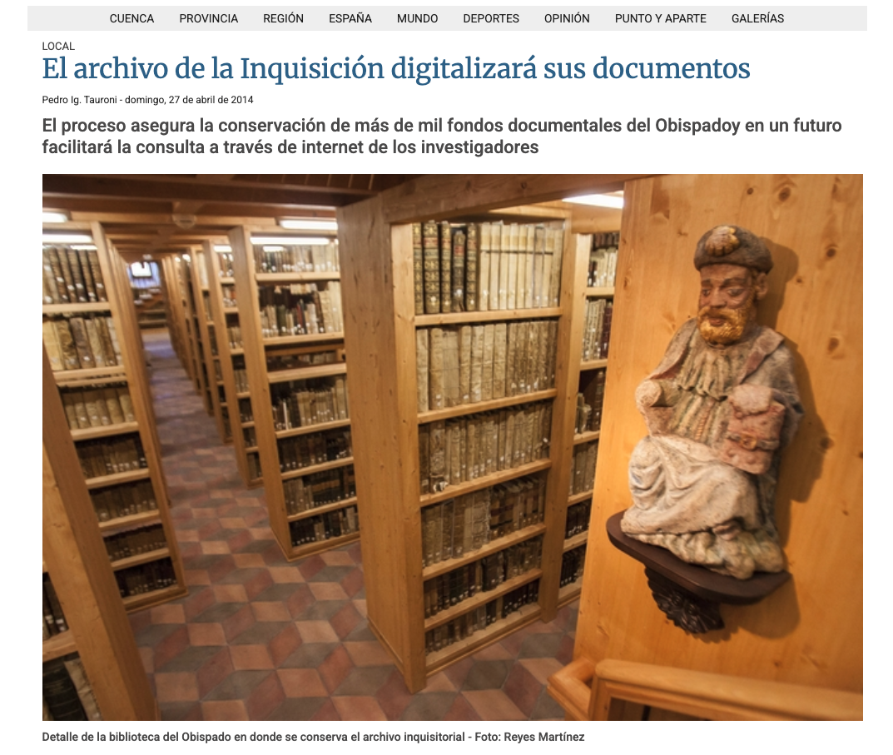
Inquisition
archives
Notes:
https://www.latribunadecuenca.es/noticia/z37f47362-98eb-7b2f-02a08aad7e3af3a8/201404/el-archivo-de-la-inquisicion-digitalizara-sus-documentos

Slide 17
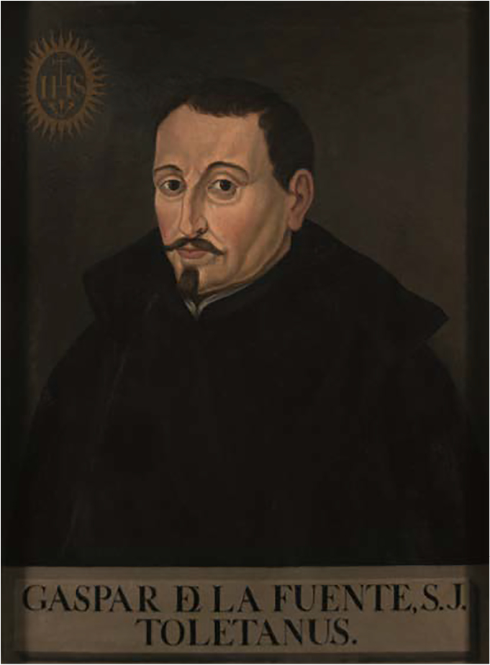
Assimilation
Many conversos assimilated into Catholic Spanish society. Gaspar de la Fuente, joined the Society of Jesus (Jesuits) “in 1556 in Alcalá de Henares, took the four vows, studied theology, and served as rector at Arévalo”
In 1499 Pedro Sarmiento’s Sentencia-Estatuto prohibited conversos from holding public or ecclesiastical offices and from testifying against Spanish Christians in courts of law.
16th-century limpieza de sangre (blood purity laws) strengthened restrictions on physical mobility and career paths for people with Jewish and Muslim ancestry
Notes:
Martín López, D. (2021). Jesuits and Conversos in Sixteenth-Century Toledo. Journal of Jesuit Studies, 8(2), 173-194. https://doi.org/10.1163/22141332-0802P002

Slide 18
Excerpt from Marina's Confession from 1494
“Most Reverend and Devout Fathers, I, Marina Gonzalez, am the wife of Francisco de Toledo, a spice merchant, who is a resident of this village of Almagro. I present myself before Your Lordships to declare … all the sins that are in my memory at the moment with great shame, contrition, and heartfelt repentance; and I intend to complete the penance that your lordships may impose. Thus I declare my guilt:
First, Reverend Fathers, I state that I sinned by observing the Sabbaths and certain Passovers that I can remember. I put on clean clothes out of ceremony, cooked on Fridays for the Sabbath, ate the food on the Sabbath, and lit an oil lamp on Friday night out of ceremony.
I sinned in that I fasted sometimes out of ceremony... and asked forgiveness from others, and others asked it of me.
I sinned because I sometimes made unleavened bread and ate it.
I sinned because I ate animals that had been ritually decapitated, and I removed the fat from the meat because of Jewish ceremony.
I sinned in hearing prayers read, and in going to hear them said. I especially remember having sometimes heard them in Alvar Lopez de Córdoba's house; he lives in Ciudad Real.
I sinned because I gave up eating pork and meat stew and things that were prohibited.
I sinned because I broke certain feast days that the Holy Mother Church ordered us to observe; I did not keep them as I ought.
I sinned through having eaten certain foods on days on which those foods were prohibited by the Holy Mother Church; I ate some things forbidden by the Church.
I sinned because on the seventh night after I had a child, some people came to my house and ate, and rested, and said it was the night of the fairies [sic].
I sinned because I ate dishes of fish at a low table during a funeral.
I state, Reverend Fathers, that I was compelled to do all the things I have just reported by two men who are married to my sisters. One is called Garcia Molina, the other Lope Rodriguez, and they reside in Ciudad Real. I was a girl at the time, and they told me I would be saved by such things…
Notes:
From Homza, Lu Ann, ed. and trans. The Spanish Inquisition, 1478–1614: An Anthology of Sources. Indianapolis: Hackett Publishing Company, 2006. P64-68
Case study: Inquisition trial of Marina González, 1494
Excerpt from Homza, Lu Ann, ed. and trans. The Spanish Inquisition, 1478–1614: An Anthology of Sources. Indianapolis: Hackett Publishing Company, 2006.p64-68
Case study Document 5: Inquisition trial of Marina González, 1494
Source is a confession
Icontext:
Marina was arrested by the Inquisition, and during her imprisonment, she was questioned, possibly under torture, and made this confession. It would have been an oral testimony recorded by a notary, although sometimes literate people made written confessions in their own hand.
Recent research has shown that confessions obtained under torture are not entirely reliable, people may well invent information to satisfy their torturerers, and obtain freedom. That being said, this source sheds light on the ways Marina observed her faith,
ACTIVITY: Take a few minutes to read this source and consider:
What Jewish traditions did Marina observe?
How did she learn about the religion and rituals?
Summing up
We see both evidence of persecution, surveillance, violent punishment, and continuing to observe tradition in this crisis condition

Slide 19
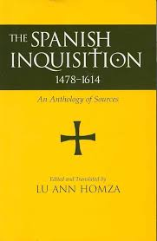
Collection of Inquisition sources in English translation
Notes:
https://www.amazon.com.au/Spanish-Inquisition-1478-1614-Anthology-Sources-ebook/dp/B076C7XDPG

Slide 20
Excerpt The oran fatwa (1504) https://portal.shariasource.com/documents/3534
As sincere and estranged [ghareeb] brothers, I ask you to pray for me beautiful prayers for a beautiful end and salvation in this world. The gathering with those whom Allāh has favored [the pious] and I advise you to adhere to the deen of Islam that you may adhere to the deen of Islam, and that you may instruct in it those of your chidren who reach maturity. If you fear that harm will result from the enemy coming to know your inner thoughts, blessed are those ghuraba[1] who do what is right when others fall into corrupt ways, for indeed he who remembers to worship Allāh when those around him forget to do so is like a man who is alive among the dead.
1) Know that idols are carved wood and hard stone which can cause you no harm and can do you no good, it is to Allāh that the kingdom belongs. Allāh did not take to Himself a son, and alongside him there is no other Allāh, so He is the one you must worship, and you must display perseverance in your adoration of him.
2) So [perform] Salat even though only by making some slight movements (bi’l-ima’)
3) And [you must contribute] ritual alms (zakat), even though as if apparently it is a hypocritical show of generosity to a beggar (for Allāh does not look at your face, but into your heart)
4) And [perform] ritual ablutions (gusl) after major pollution, even though by plunging into the sea.
5) If you are prevented from praying, then you should make up at nighttime what you have had to omit during the day; and when ritually pure water is for practical purposes lacking, then you must wipe yourself clean [in the ritually approved fashion—tayammum], even if it is just by rubbing your hands clean on a wall….
6) If, at the hour of prayer, they force you to prostrate yourself before their idols, or make you attend their prayers, maintain it as your firm intention to consider what they do as forbidden, and have it as your desire to carry out the prayer prescribed by Islamic law, bow down to whatever idols they are bowing to, but turn your intention towards Allāh…
7) If they oblige you to drink wine, you may do so, but let it not be your intention to make use of it.
Notes:
Analysis (paywalled) Bernabé Pons, Luis F. "Fatwa del muftí de Orán." In Christian Muslim Relations Online II, edited by David Thomas. Brill, 2015. https://doi.org/10.1163/2451-9537_cmrii_COM_27442.
Open access sources: https://portal.shariasource.com/documents/3534
Also here https://historyofandalus.wordpress.com/appendix-a/appendix-v/ill
Primary source : The oran Fatwa (1504)
In 1504 a Moroccan jurist (Ahmad ibn Abi Jum'a al-Maghribi al-Wahrani), issued a fatwa, or religious ruling, addressed to Muslims in Spain, and specifically the Moriscos - forced converts. Ahmad ibn Abi Jum’a was a professor of Islamic law in Fez when he wrote this docuemnt. It is the only text that clearly pronounces on how Muslims should follow their own way of life under Christian rule, specifically in Spain.
Source analysis activity:
What does the source tell us about how Muslims altered the practice of their faith in the face of religious oppression? What rituals or practices changed?
What does the source reveal about Morisco assimilation into Hispanic Catholic societies in the aftermath of the fall of granada?

Slide 21
The Reconquista Goes Global

Slide 22
Spain and the World:
The campaign against Idolatry in the Americas coincided with attacks in Judaism and Islam in Europe
Key dates in the conquest of the Americas
1492: Colombus’s first voyage to the Americas
1521: Fall of Aztec capital Tenochtitlan,
1532: Capture of the Inca Atahualpa, ruler of the kingdom of Peru
1571: Capture of Manila

Slide 23
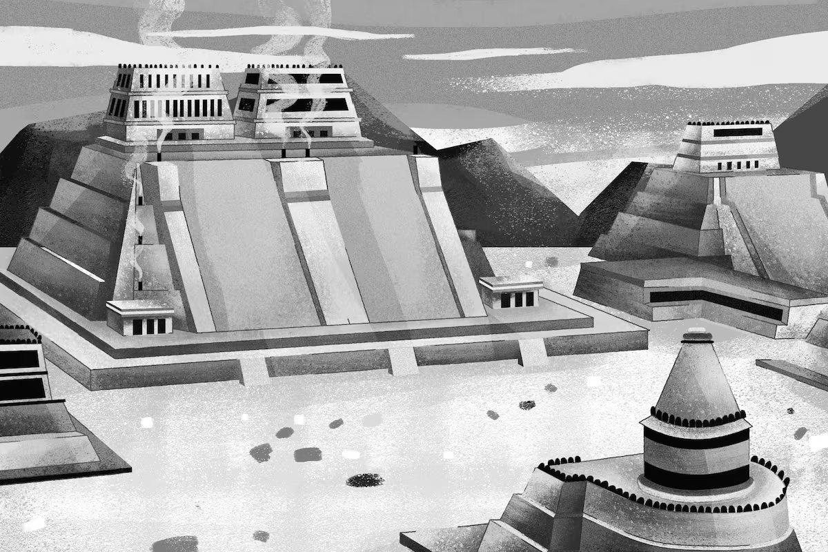
Artist’s impression of the Templo Mayor (2021)
Notes:
Image published in El Pais (2021) https://elpais.com/mexico/2021-08-03/el-templo-mayor-cambio-la-cara-de-ciudad-de-mexico.html
Templo Mayor
Tenochtitlan, the capital city of the Aztec Empire, was founded in the early 14th century/ 1300s. The capital was built in a lake across a series of natural and artificial islands connected by causeways, and became one of the largest cities in the early modern world with a population of perhaps 200,000 when the first Spanish conquistadors arrived around 1520.
The Templo Mayor was the city’s most important building. This 60m tall pyramid structure was a religious complex dedicated to two major Aztec deities: Huitzilopochtli - the god of war, sun, and human sacrifice, and Tlaloc - the god of rain, water, and agricultural fertility.

Slide 24
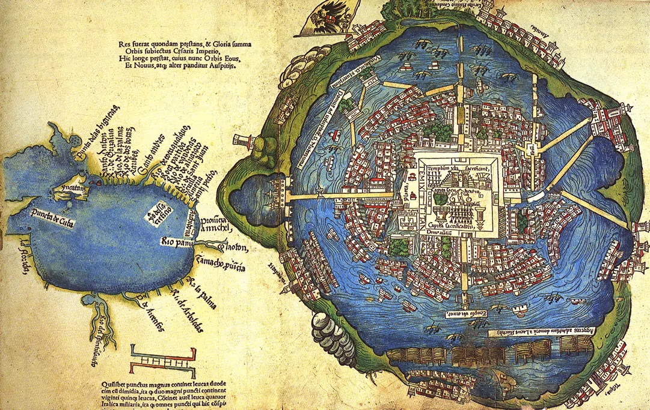
Notes:
The map https://www.historytoday.com/archive/cartography/map-tenochtitlan-1524
The templo major is also visible on this map of the city of Tenochitlan printed in Nuremberg in 1524 along with copies of Hernán Cortés’ letters to Emperor Charles V translated into Latin. T. This was the first image of Tenochtitlan that reached Europe.

Slide 25
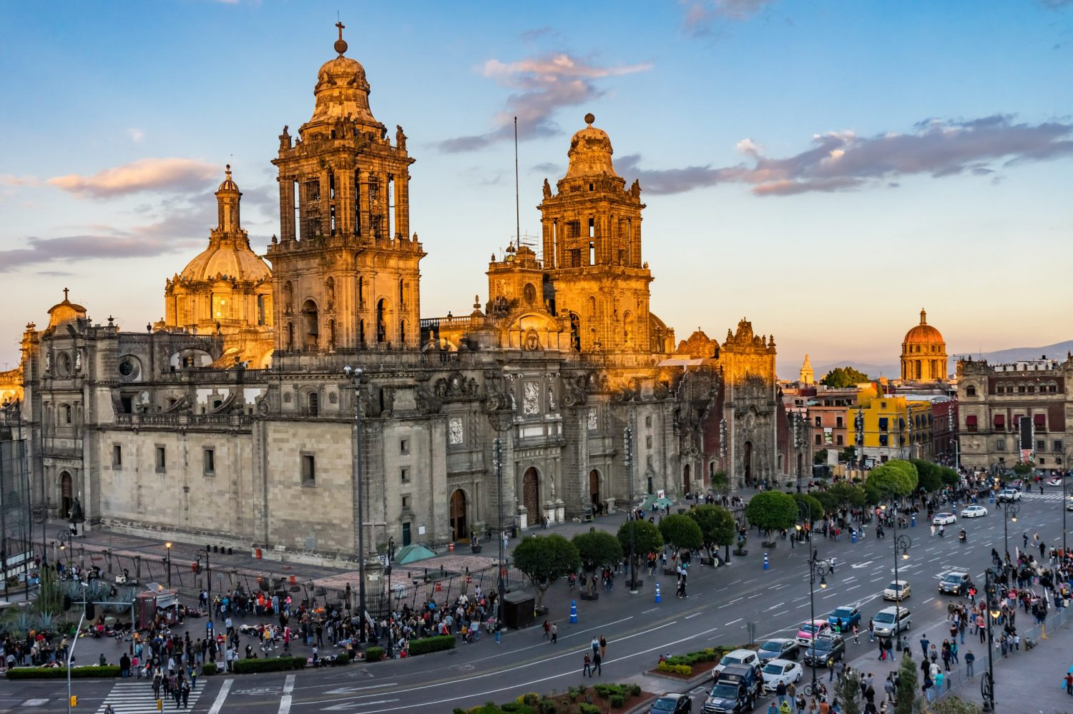
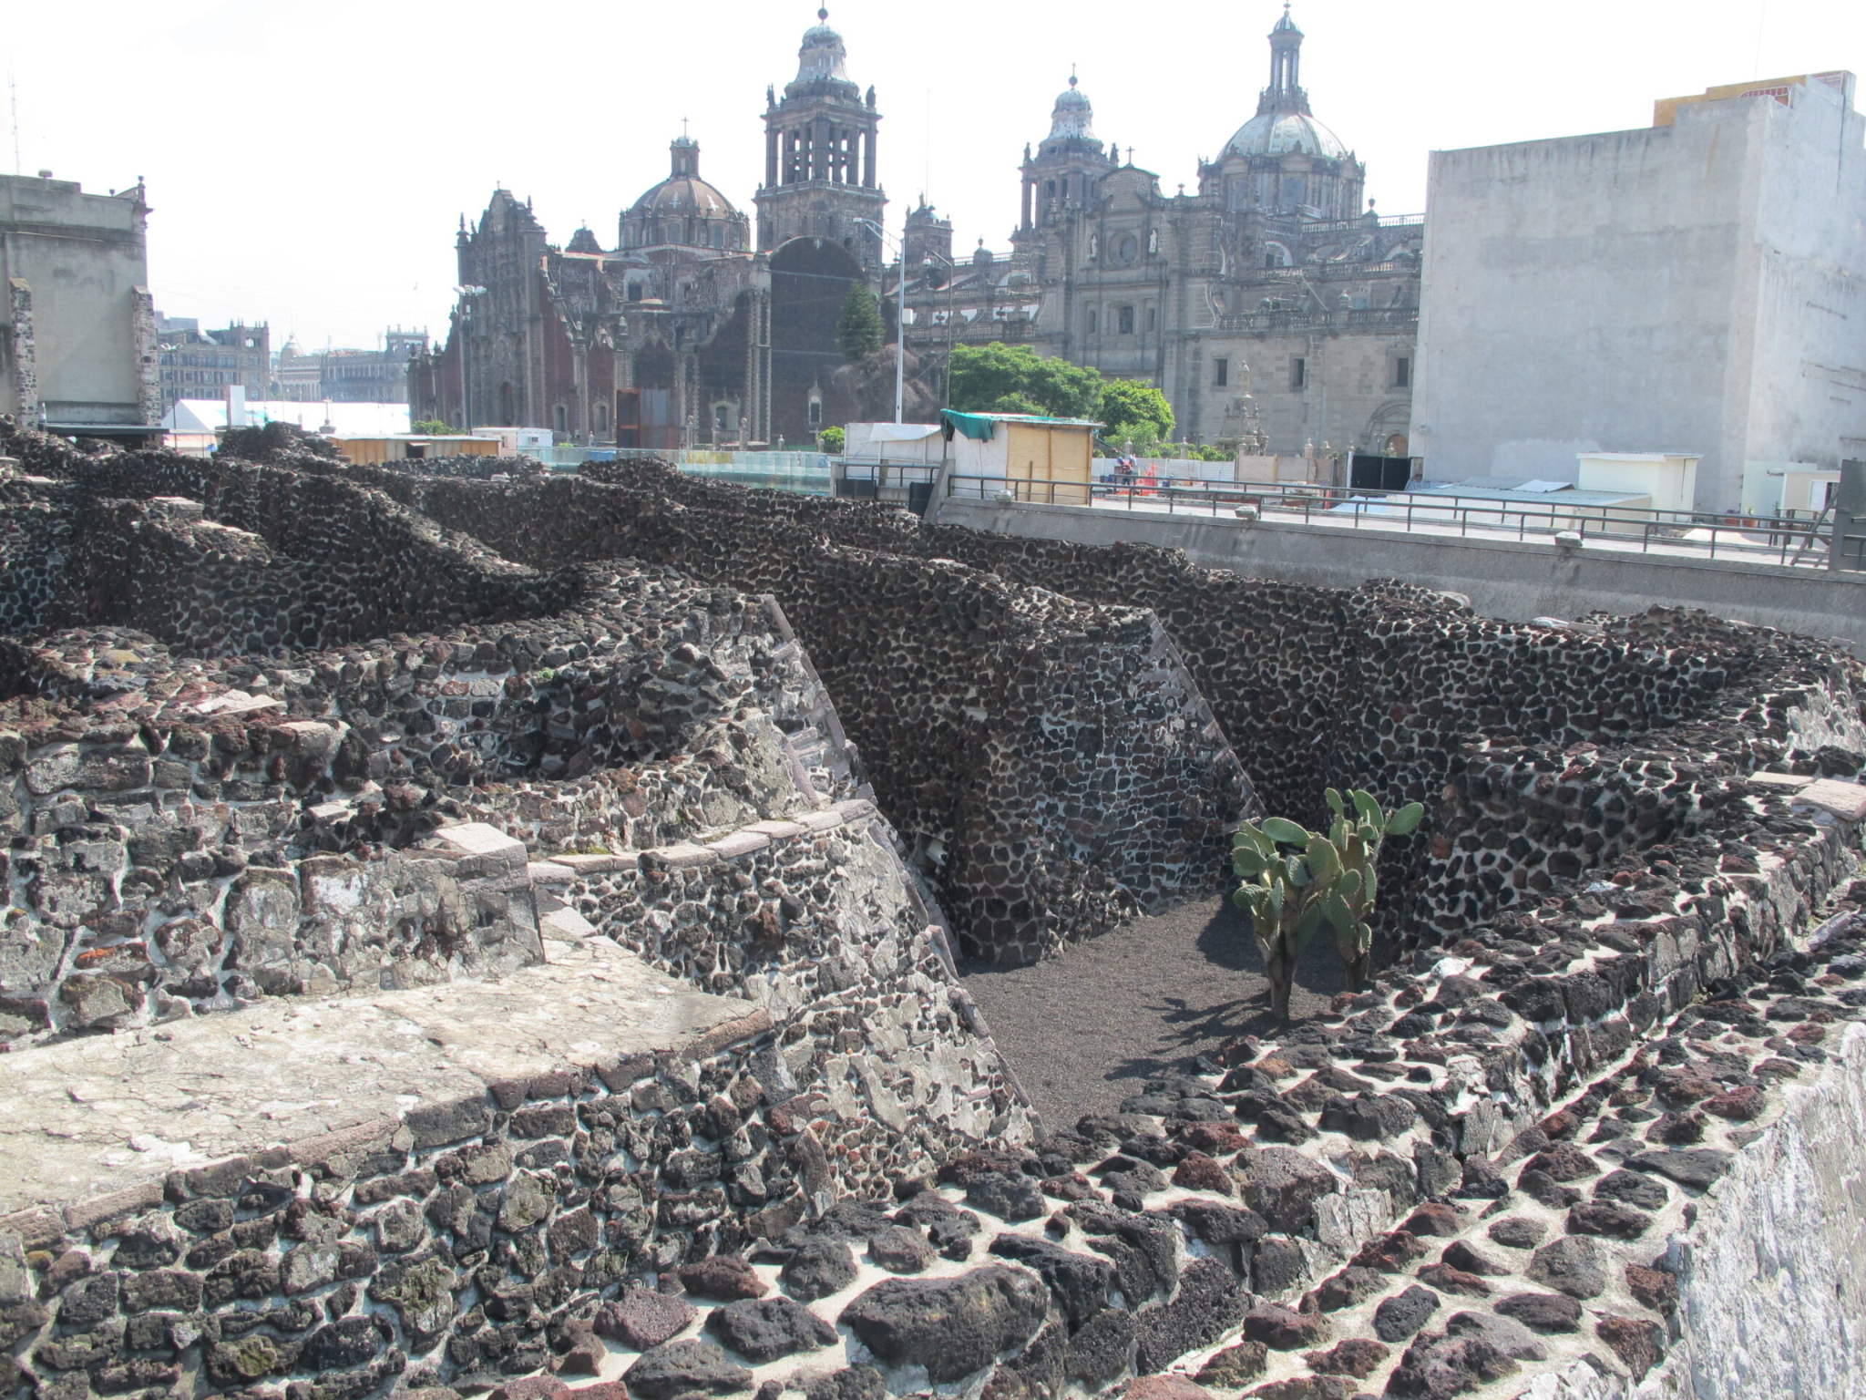
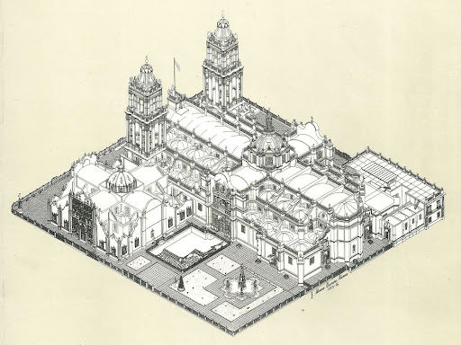
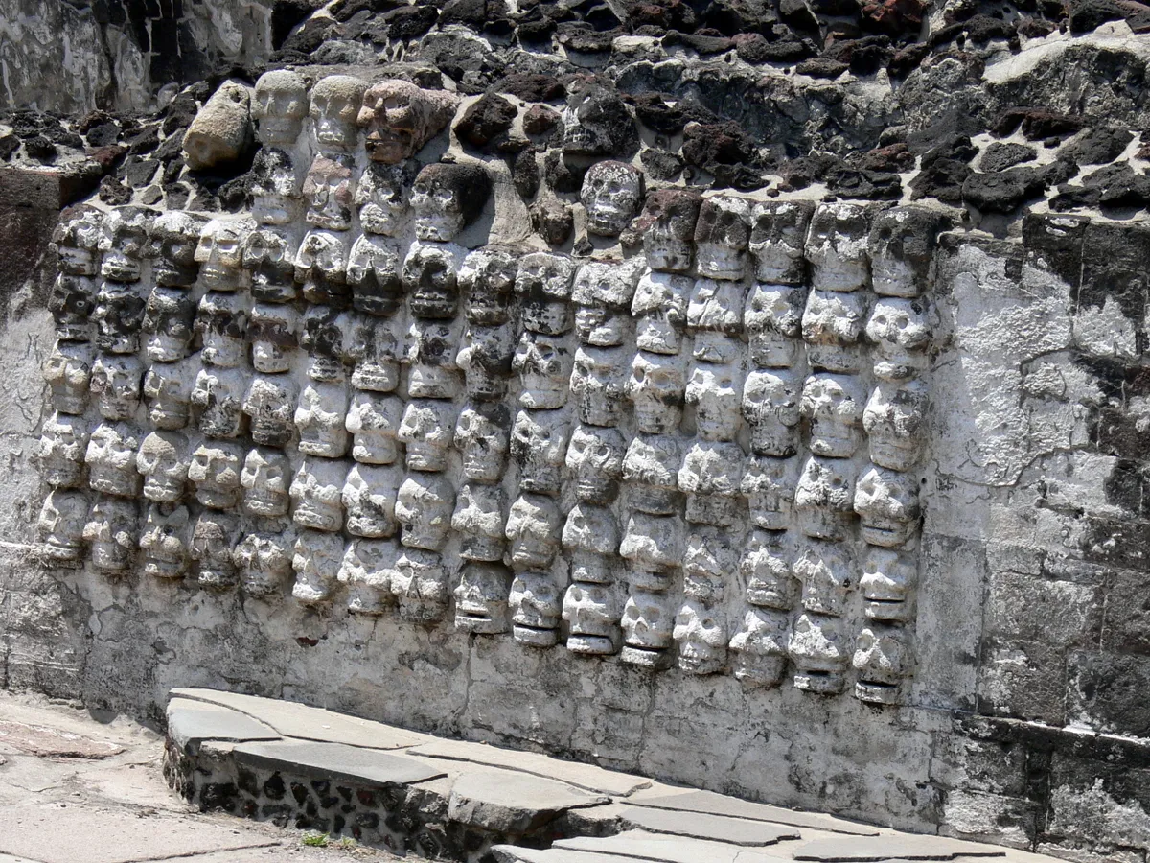
Notes:
Top left: Mexico City’s Cathedral
Bottom Left: Digital rendition of Cathedral
Top right: Photograph showing cathedral with excavated foundations of the templo mayor in the foreground
Bottom right: excavated ‘wall of skulls’, templo mayor
Spanish conquistadors led by Hernán Cortés systematically destroyed the templo in 1521, following the fall of Tenochtitlan.
Stones from the templo were reused to build the Metropolitan Cathedral and other colonial structures, deliberately and symbolically erasing Aztec religious authority.
Ruins of the templo mayor were (re)discovered by city workers in 1978, and over decades that followed, the archeological site was excavated and is now an important cultural site and museum.

Slide 26
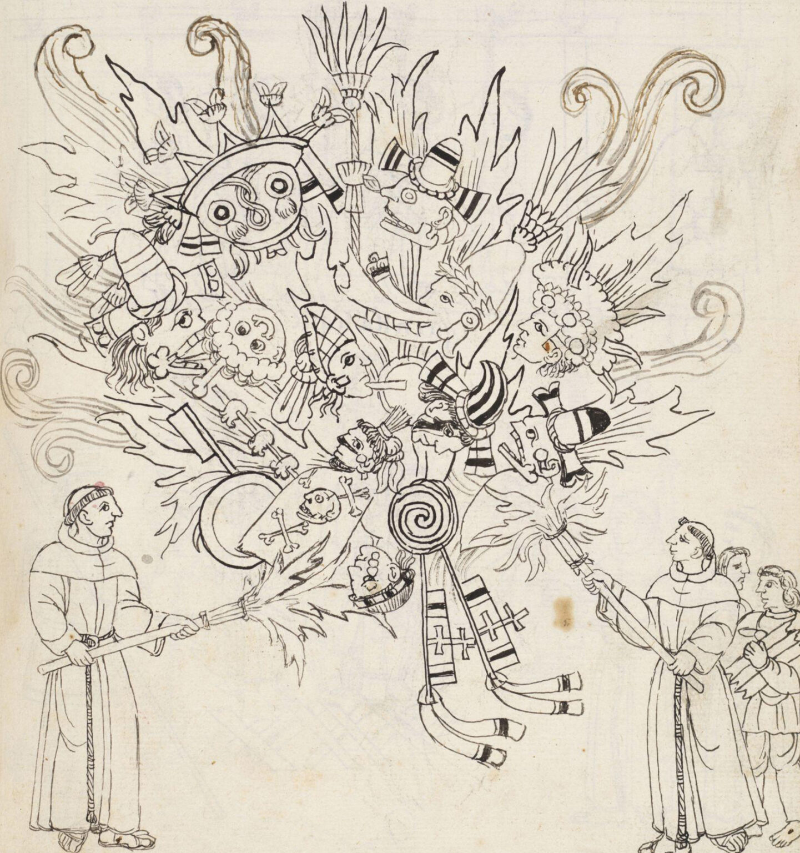
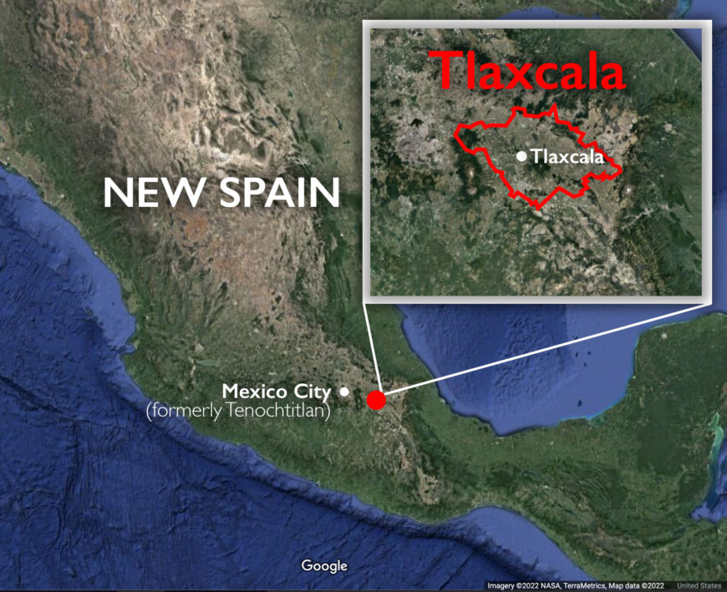
“Burning of the Idols,” in Diego Muñoz Camargo’s Description of the City and Province of Tlaxcala (c.1581-84
Notes:
“Burning of Idols,” drawn by an unidentified Indigenous artist, to accompany Diego Muñoz Camargo, Description of the City and Province of Tlaxcala, c. 1581–84 (Ms. Hunter 242, fol. 242r, Glasgow University Library, Scotland, CC BY-NC 4.0)
Spanish attacks on religion in central Mexico extended beyond urban space and architecture. The century after the conquest of Tenchitlan saw devastating campaigns to destroy the material culture of Indigenous peoples that missionaries and government officials believed believed undermined or threatened their attempts at evangelization.
Primary source.This is an image that scholars have titled “Burning of Idols”. It was drawn by an unidentified Indigenous artist to accompany Diego Muñoz Camargo’s manuscript known as the Description of the City and Province of Tlaxcala, created in the late sixteenth century, between 1581 and 1584. (This was kind of history of the Tlaxcalan region before.)
This image relates to what some art historians have called the war on images that occurred after the Spanish conquest. It depcits two Franciscan friars – members of one of the Catholic missionary orders directly responsible for the conversion of the Indigenous population to Christianity – destroying the material culture of Indigenous peoples.
The viewer’s attention is focused on what is being burned: the large mass of objects and materials associated with Mesoamerican divinities from Central Mexico who were worshipped prior to the Spanish invasion, here up in flames.
We can identify this large figure at the top with goggle eyes is Tlaloc, the god of rain.
We can also see banners and flags in the flames
Scenes like this came to pass on active missions in the Americas. Many objects associated with Indigenous religion and knowledge were burned or destroyed by the clergy in what have been called “extirpation campaigns.” If you’ve ever wondered why so few prehispanic manuscripts survive today, it is because many of them ended up on bonfires.
One Franciscan friar missionizing in the Yucatan, Diego de Landa, noted that Maya books were thought to contain nothing but “superstitions and falsehoods of the devil” and so he had them burned. Historians estimated that he destroyed more than 5,000 objects (books among them) in a single bonfire.
We can see two slightly smaller figures wedged into the right side of the image. They represent Tlaxcalan boys bringing kindling for the fire. The artist shows them as active participants in the destruction of their own cultural heritage. Whether or not this was accurate, the image conveys the idea that some Indigenous peoples willingly sided with missionaries to bring Christianity to the Americas. This text tried to emphasise that Tlaxcalans were good Christians.

