Slide 1
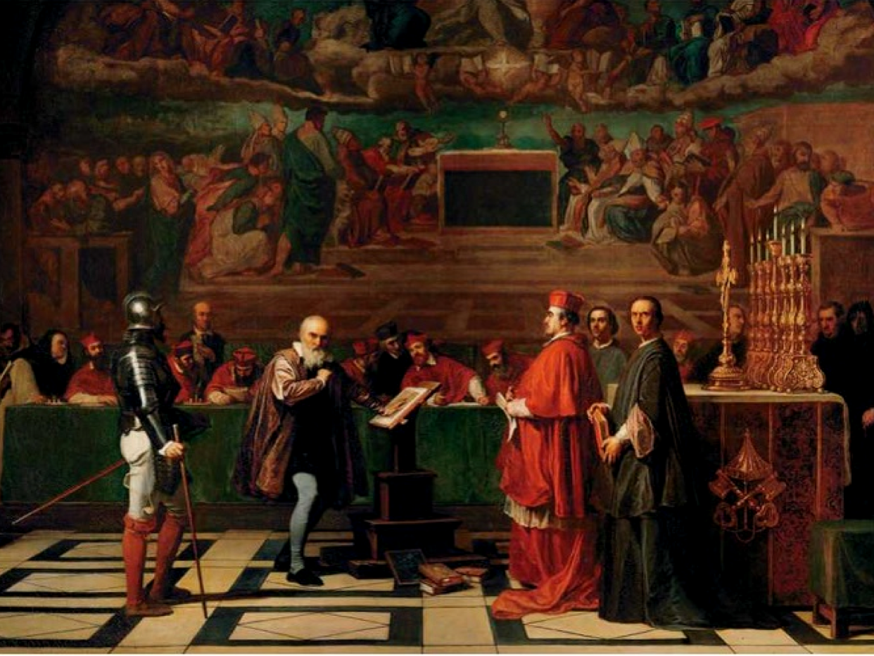
The Galileo Affair
Dr Kristian Camilleri
School of Historical and Philosophical Studies
RASNET Conference
19 February 2018

Slide 2
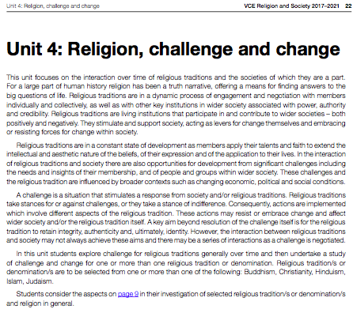
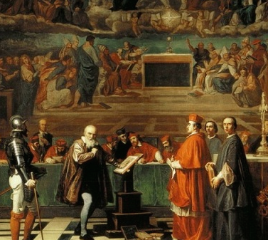

Slide 3
Unit 4: Religion, Challenge & Change
The religious tradition: Roman Catholicism
The challenge: Heliocentrism? or Protestantism?
The stance – The injunction of 1616?
The publication of The Dialogue on the Two Chief World Systems in 1632
The action – Galileo was tried on the charge of “vehement suspicion of heresy’ in 1633.
Each was shaped by contingent historical circumstances

Slide 4
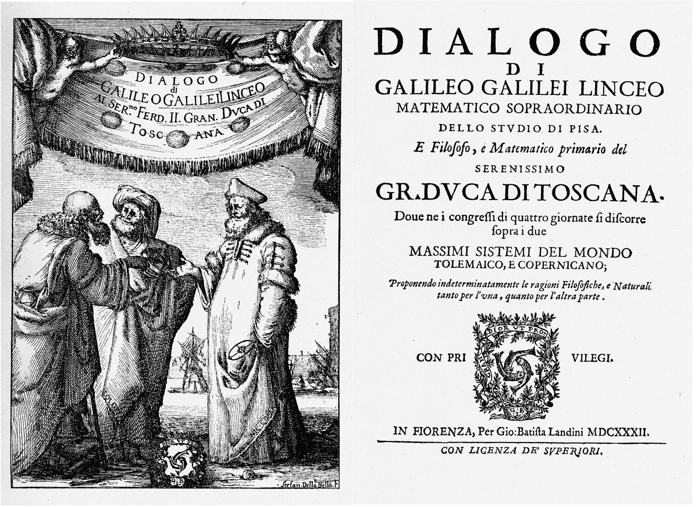
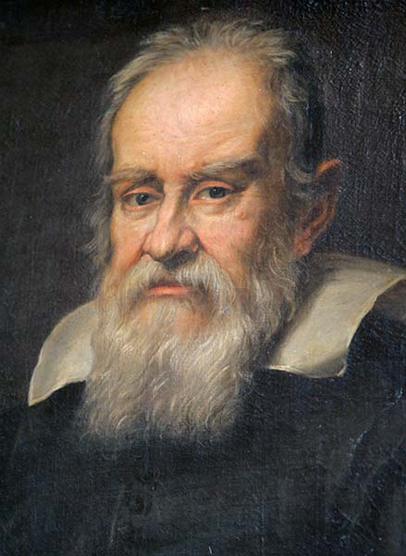
The Two World Systems

Slide 5
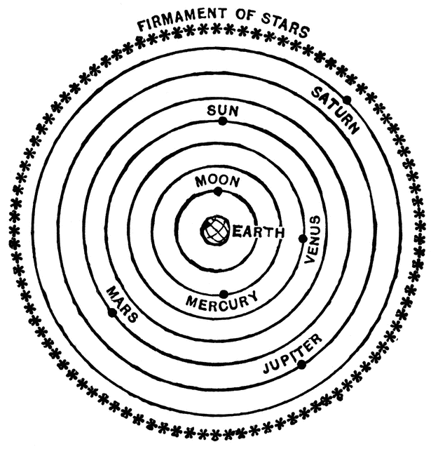
The Ptolemaic System
Developed by Ptolemy of Alexandria in 2ndC CE
The earth is spherical and immobile
The earth is located at the centre of the universe
The moon, sun, planets, and stars revolve around the earth
The universe is spherical

Slide 6
The Motion of the Planets
All celestial bodies obey the principle of uniform circular motion.
But the planets do not appear to move in regular circular paths.
Planets exhibit certain ‘irregularities’, which became of central importance to Greek tradition of mathematical astronomy.
The challenge for Greek astronomy was to find a system of uniform circular motions which accounted for the apparent motions of the planets

Slide 7
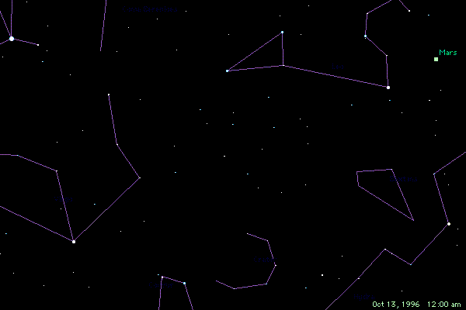
The Retrogression of Mars

Slide 8
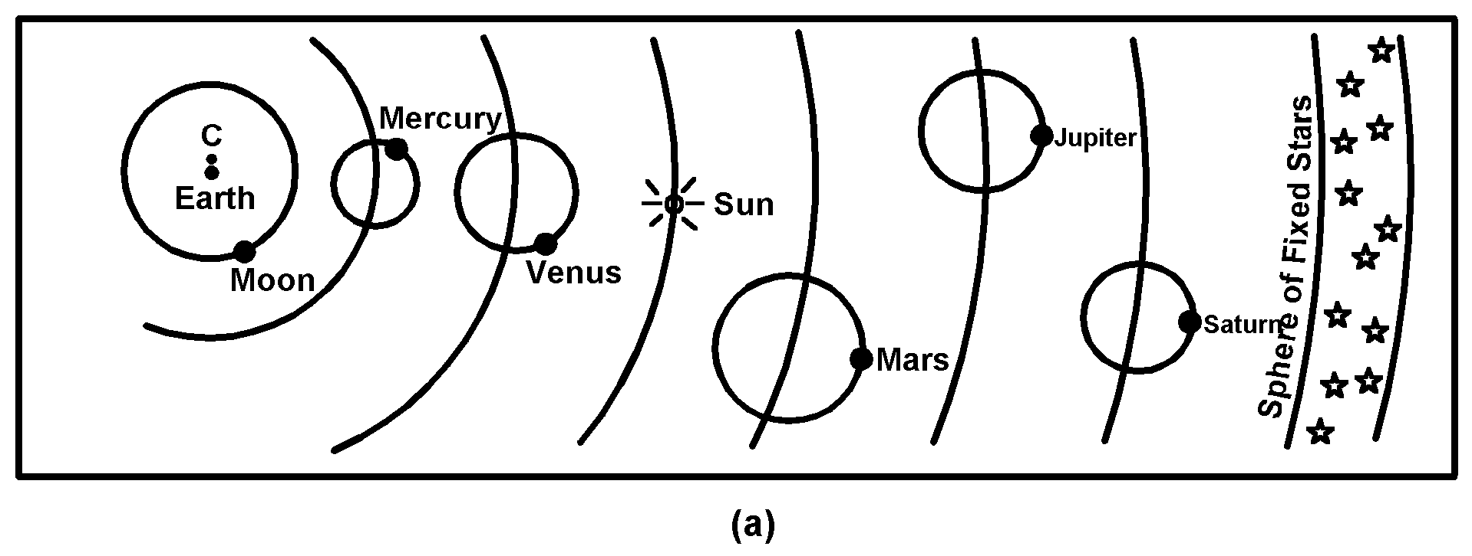
Ptolemy’s Mathematical Astronomy
https://www.youtube.com/watch?v=QKtWtYuReBU
https://brunelleschi.imss.fi.it/itineraries/multimedia/PtolemaicSystem.html

Slide 9
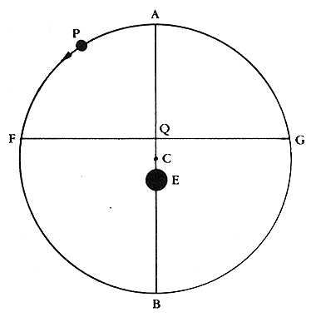
The Devices of Ptolemaic Astronomy
Epicycle: The planet orbits a small circle, which in turn revolves around the earth
Equant: The speed of the planet is uniform with respect to an imaginary point Q. The planet travels from A to F in the same time it takes to travel from F to B.
Eccentric: The earth is placed just off the centre of the planetary orbit

Slide 10
Medieval Attitude to Astronomy
To assert the existence of an eccentric sphere or an epicyclic sphere is contrary to nature… The epicycle and the eccentric are impossible… what we have is something that fits calculation but does not agree with reality.
Averroes, Metaphysics (c. 1190)
However I have already explained to you ... that all this does not affect the astronomer. For his purpose is not to tell us in which way the spheres truly are, but to posit an astronomical system in which it would be possible for the motions to be circular and uniform and to correspond to what is apprehended through sight regardless or not of whether things are thus in fact.
Maimonides, Guide for the Perplexed (c. 1200)

Slide 11
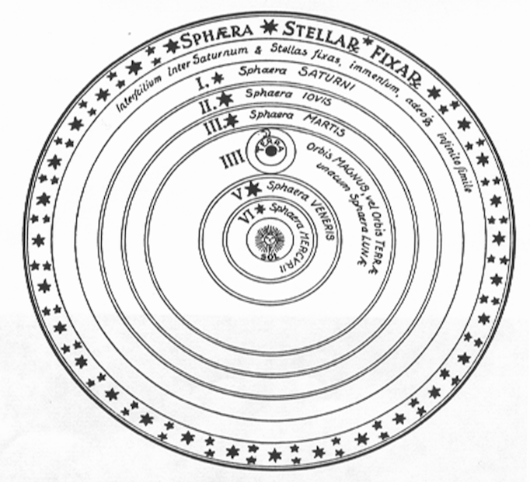
The Copernican System
In 1512 Nicholas Copernicus proposed the sun was the centre of the universe
In this system, the earth was the third planet, rotating on its axis every day and revolving around the sun every year. De revolutionibus orbium coelestium (1543)

Slide 12
Copernican Astronomy
Copernican modeled his astronomy on the Ptolemaic system. It retained
the spherical model
uniform circular motion (eliminating the equant)
epicycle-deferent system (even with a double-epicycle for the moon!)
finite spherical universe
Copernicus’ system offered a more elegant solution to the problem of planetary motion than Ptolemy’s.
It used fewer epicycles (but still employed epicycles and eccentrics)
It was no more empirically accurate than Ptolemy’s system.

Slide 13
How Accurate was Astronomy?
For a few weeks every 32 years, both the Ptolemaic and Copernican predictions for the position of Mars are off by close to 5 degrees
In 1609 Kepler proposed a new astronomy to overcome these discrepancies based on the idea that the planets moved in elliptical orbits. This was rejected by Galileo.

Slide 14
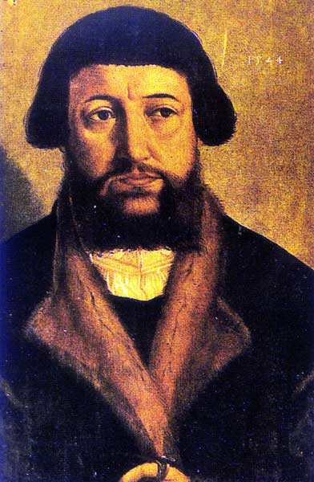
Osiander’s Preface (1543)
[Since the astronomer] cannot in any way attain to the true causes, he will adopt whatever suppositions enable the motions [of the celestial bodies] to be computed correctly from the principles of geometry for the future as well as the past… These hypotheses need not be true or even probable. On the contrary, if they provide a calculus consistent with the observations, that is enough.
Andreas Osiander, De Revolutionibus (1543)

Slide 15
The Copernican Theory
A number of astronomers actually used the Copernican system to make calculations of planetary motion in the 16th C.
But they did not regarded it as representing the true structure of the cosmos
Philipp Melanchthon (1497-1560)
Giovani Magini (155-1617)
Erasmus Reinhold (1511-1553)
Reinhold used the Copernican system in his Prutenic tables (1551)

Slide 16
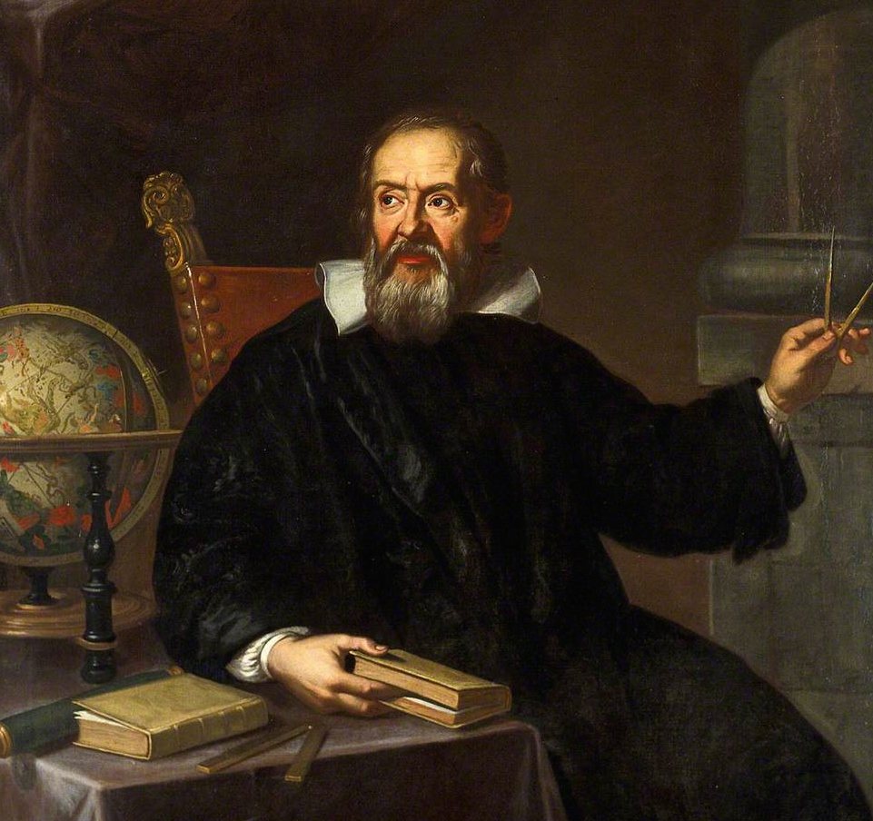
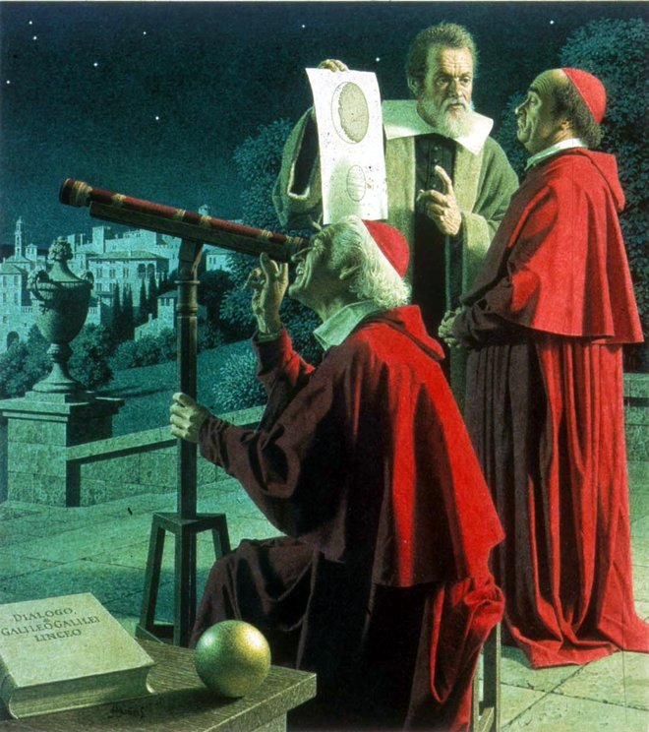
Galileo Galilei (1564-1642)
In 1609-1613, the Italian mathematician and philosopher, Galileo Gailei made a series of sensational new observations using a telescope

Slide 17
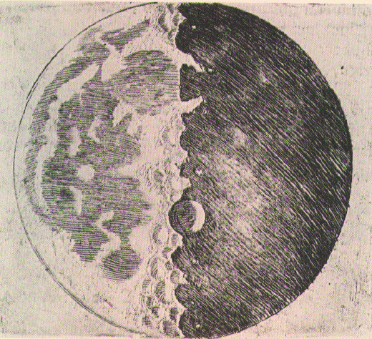
New Discoveries in the Heavens
Galileo’s observations challenged the terrestrial-celestial distinction.
craters and valleys on the the moon (1609)
moons of Jupiter (1609)
phases of Venus (1610)
sunspots (1612)
handles of Saturn (1613)

Slide 18
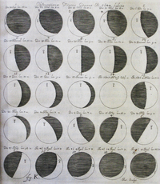
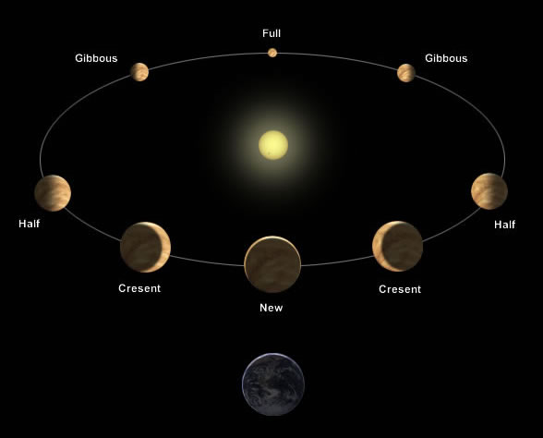
The Phases of Venus

Slide 19
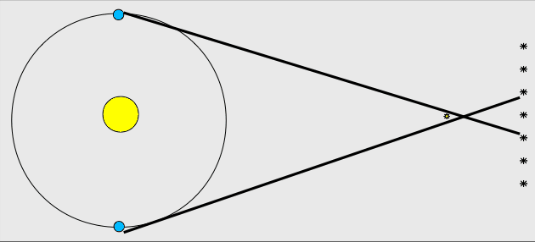
The Absence of Stellar Parallax
To explain this absence, Copernicans proposed that the stars must be hundreds of times further away than previously assumed.

Slide 20
Arguments against Copernicanism
A moving earth violated Aristotelian physics.
If the earth is rotating, why does a cannon ball fired directly upward fall to the same spot, and not miles to the west?
The “Coriolis effect” (the rotation of the earth should cause a cannon ball fired to the north to deflect to the east)
If the does in fact earth move, what is the cause of the earth’s motion?
Telescopic observations of the stars showed that they would have to be bigger than the entire planetary system (in a Copernican universe).

Slide 21
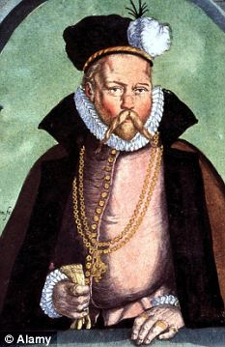
An Alternative: The Tychonic System
In the Dialogue, Galileo treated the two chief world systems: the Ptolemaic and the Copernican
But in 1580, the Danish astronomer Tycho Brahe had developed an alternative geo-heliocentric model
By 1630 most Jesuits believed the choice lay between Tycho and Copernicus.
Tycho’s system was widely endorsed.

Slide 22
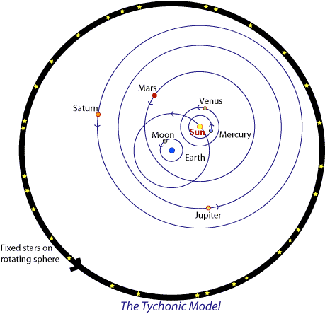

Slide 23
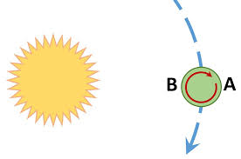
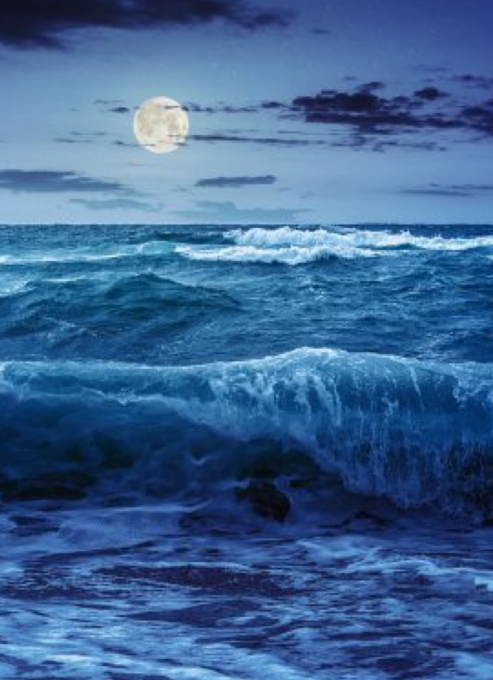
Galileo’s Theory of the Tides
Conclusion: In 1633 it was rational to oppose Copernicanism

Slide 24
The Interpretation of Scripture
Protestantism | Catholicism
Sola scriptura Rejection of any original infallible authority other than the Bible. All secondary authority is derived from the authority of the Scriptures | The Patristic tradition The Church reserves sole authority over the correct interpretation of scripture

Slide 25
The Decree of the Council of Trent
Furthermore to control petulant spirits, the Council decrees that, in matters of faith and morals pertaining to the edification of the Christian doctrine, no one, relying on his own judgment and distorting the Sacred Scriptures to his own conceptions, shall dare to interpret them contrary to that sense which Holy Mother Church, to whom it belongs to judge of their true sense and meaning, has held and does hold, or even contrary to the unanimous agreement of the Fathers, even though such interpretations should never at any time be published. Those who do otherwise shall be identified by the ordinaries and punished in accordance with the penalties prescribed by law.
Decrees of the Council of Trent, (1545-1563) Session IV, 8th April 1546.

Slide 26
Was Copernicanism Compatible with Scripture?
Geostatism (the stationary earth) agreed with a literal interpretation of Scripture in several places
1 Chronicles 16:30
Psalm 93:1
Psalm 96:10
Psalm 104:5
Ecclesiastes 1:5
Job 26:7 (varied interpretations)
Heliocentrism contradicted the prevailing theological support of the theory

Slide 27
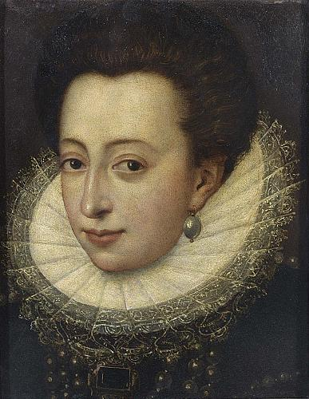
Interpreting the Bible Literally?
It was generally agreed that some biblical language should be interpreted figuratively
The scriptures refer to π as 3/1 or 21/7. Archimedes showed the ratio is really ≈ 22/7.
There is no reason to think that biblical writers intended their words to be taken in an excessively literal fashion.
Every passage must be dealt with on its own merits.
Grand Duchess Christina (1565-1637)

Slide 28
Galileo’s Letter to the Grand Duchess Christina (1615)
God is the author of two books – the book of nature and the book of scripture – which cannot come into conflict with one another
The literal reading – “the unadorned grammatical can lead to error”
Appeal to St Augustine: where natural philosophy has evident fact or proof, one should interpret the scriptures accordingly.
Purpose of the Bible is to teach faith and morals: “The intention of the Holy Spirit is to teach us how to go to heaven, not how the heavens go” (Cardinal Baronius)
Where the scripture appear to refer to parts of nature, they have to given an ethical and theological interpretation.

Slide 29
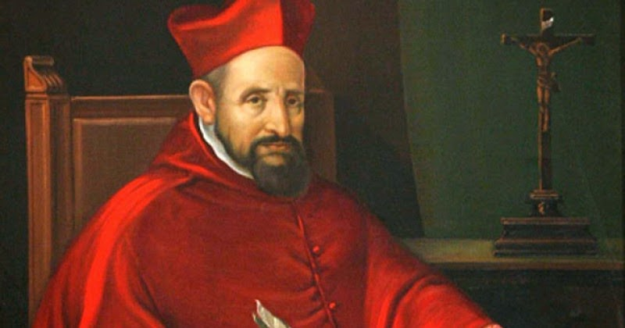
The Church’s Stance on Heliocentrism
Cardinal Robert Bellarmine (1542-1621)

Slide 30
Bellarmine’s Letter to Foscarini
[When discussing the Copernican system] you … act prudently when you content yourselves with speaking hypothetically and not absolutely… But to want to affirm that the Sun, in very truth, is at the centre of the universe and only rotates on its axis without traveling from east to west, and that the Earth … revolves very swiftly around the Sun, is a very dangerous attitude and one calculated not only to arouse all Scholastic philosophers and theologians but also to injure our hold faith by contradicting the Scriptures… [A]s you know, the Council of Trent forbids the interpretation of the Scriptures in a way contrary to the common agreement of the Holy Fathers. Now if your Reverence will read, not merely the Fathers, but modern commentators on Genesis, the Psalms, Ecclesiastes, and Joshua, you will discover that all agree in interpreting them literally as teaching that the Sun is in the heavens and revolves round the Earth with immense speed and that the Earth is very distant from the heavens, at the centre of the universe, and motionless.
Bellarmine to Foscarini, 4 April 1615

Slide 31
Bellarmine’s Letter to Foscarini
I say that whenever a true demonstration would be produced that the sun stands in the centre of the world and the earth in the third heaven, and that the sun does not rotate around the earth but the earth around the sun, then at that time it would be necessary to proceed with great caution in interpreting the scriptures which seem to be contrary, and it would be better to say that we do not understand them than to say that what has been demonstrated is false. But I do not believe that there is such a demonstration, for it has not been shown to me… I have the greatest doubts about the [possibility of such a demonstration]… And in case of doubt one should not abandon the Sacred Scriptures as interpreted by the Holy Fathers.
Bellarmine to Foscarini 12 April 1615

Slide 32
The 1616 Judgment
In early 1616 the matter was referred to “qualifiers”. Their judgment was
The proposition that the Sun is stationary at the centre of the universe is "foolish and absurd in philosophy, and formally heretical since it explicitly contradicts in many places the sense of Holy Scripture according to the proper meaning of the words according to the common interpretation among the Holy Fathers and of learned theologians"
The proposition that the Earth's is not at the centre of the world and is not immobile, but moves as a whole and also with a diurnal motion "receives the same judgment in philosophy; and ... in regard to theological truth it is at least erroneous in faith”.
Holy Office, 24th February 1616.

Slide 33
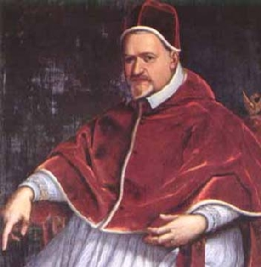
The 1616 Injunction Against Galileo
The Most Holy Father has ordered the illustrious Cardinal Bellarmine to call before Galileo and to advise him to abandon the said opinion [Copernican theory]; and if he should refuse to obey, the Commissary, before a notary and witnesses, should impose on him an injunction to abstain completely from teaching or defending that doctrine and opinion or from discussing it; and if he should not agree, he is to be imprisoned.
Pope Paul V to Cardinal Bellarmine 25 April 1616.
Pope Paul V (1551-1621)

Slide 34
Three Documents
Inquisition minutes note Bellarmine’s official report that Galileo acquiesced when advised of the decision by the Holy Office (3rd March 1616)
An unsigned (Illegal?) report of the meeting in Rome saying Galileo “was told not to hold, teach, or defend it in any way whatever, verbally or in writing.” Galileo did not know of the existence of this document.
A letter from Bellarmine to Galileo, stating he could not "hold or defend" the Copernican view, but leaving open whether he was permitted to discuss it. The Holy Office did not know of the existence of this latter until Galileo produced it during the Trial of 1633.

Slide 35
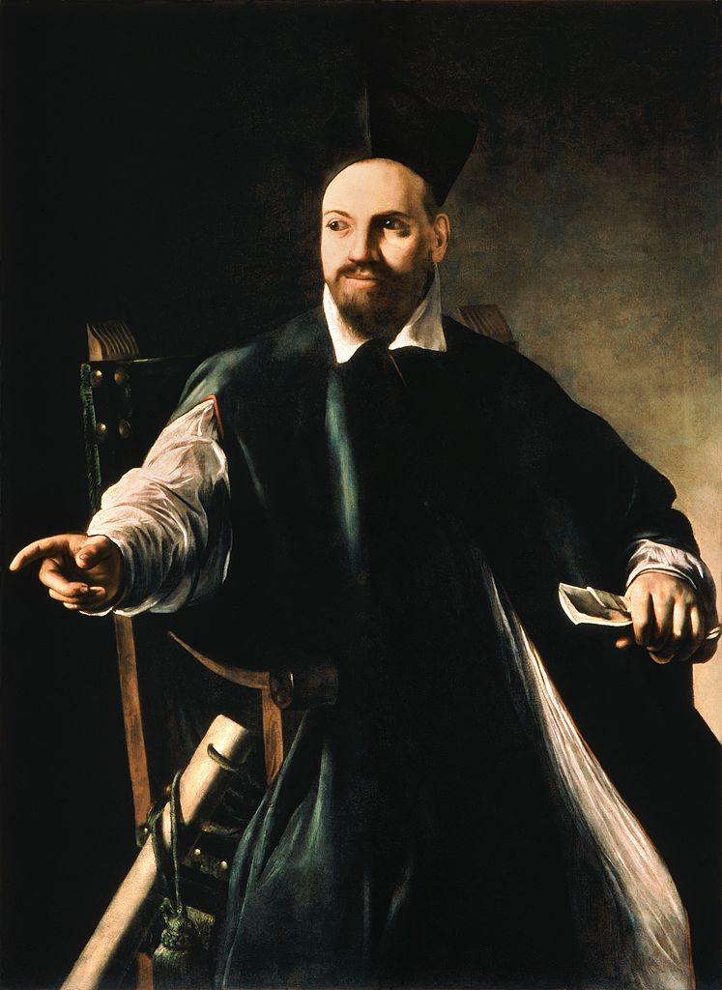
Mixed Messages?
In 1624 Galileo granted 6 audiences with the new Pope, Urban VIII, his old friend (Maffeo Barbernini).
Galileo was permitted to discuss the Copernican view so long as it remained within mathematical astronomy.
The Pope reiterated the theological argument that one could never prove the heliocentric view to be true.
Galileo began writing The Dialogue.

Slide 36
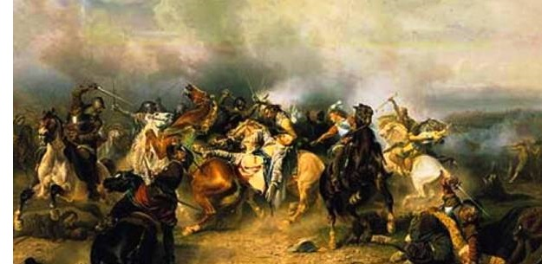
The Thirty Years War (1618-1648)
One of the longest and most destructive conflicts in human history (8 million fatalities)

Slide 37
The Turmoil of the 30-Years War
Initially a war between various Protestant and Catholic states in the fragmented Holy Roman Empire, gradually, it developed into a conflict involving most of the great European powers
Disputes over internal politics and the balance of power increasingly dominated the war. Tensions between France and the Hapsburg powers escalated.
By 1630 Catholicism was on the verge of becoming extinct in Germany.
Pope Urban VIII, elected with support of French Cardinals, was accused of sympathizing with France, which opposed the Empire in the war
The Spanish ambassador, Cardinal Borgia, threatened to impeach the Pope in 1632.

Slide 38
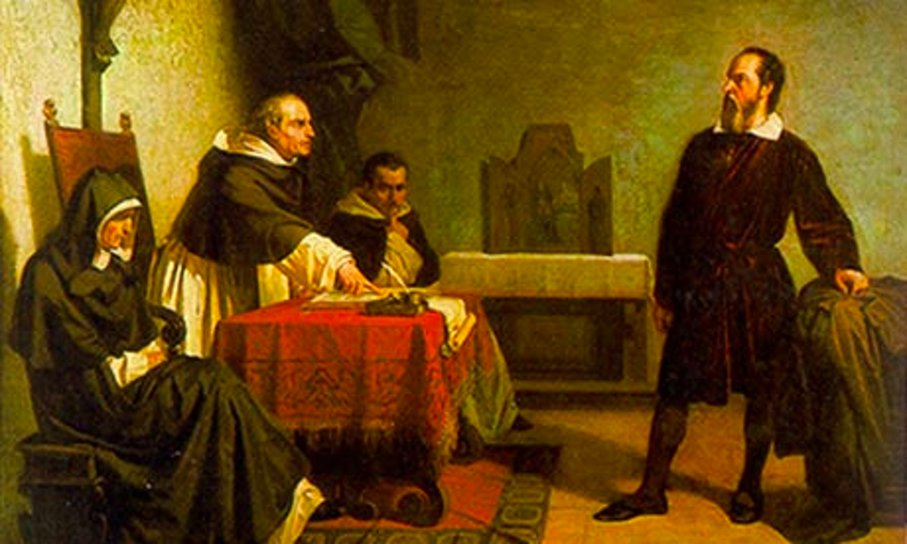
The Trial of 1633
The publication of the Dialogue deeply angered the Pope. Galileo was duly summoned to Rome to answer the charge of “vehement suspicion of heresy”

Slide 39
The Downfall of Galileo
Punishing Galileo would send a highly visible message. The Pope still controlled powerful men. Far more than Copernicanism at stake!
Galileo had become a pawn in a political game. He was to be a ritual sacrifice
The rhetoric surrounding Galileo was always harsher than his actual treatment. After the outcome had been arranged, Urban made Galileo into an example.
Torture was never authorized. Galileo was sentenced to imprisonment, commuted to house arrest, and was forced to recite the 7 penitential psalms a week for 3 years.
He was prohibited from ever publishing again, though he did.

Slide 40
Was the Galileo Affair a Case of Science versus Religion?
What appear to be conflicts between science and religion are often conflicts over political power and authority.
The Galileo affair was an affair of immense complexity
It was not (simply) a conflict between science and faith, rationality and irrationality, nor simply a matter of the suppression of intellectual freedom.
Conflicts between science and religion are often between rival scientific interests, or conversely between rival theological factions.

Slide 41
Recommended References
Finochiaro, M. A., The Trial of Galileo: Essential Documents. Cambridge; MA., Hackett Classics, 2014. [An edited collection of the historical documents]
Ernan McMullin (ed.), The Church and Galileo, University of Notre Dame Press, 2005. [An collection of essay from different scholars on the Galileo Affair]
Pettersen, M. S., Purnell, F. & Carnes, M., The Trial of Galileo: Aristotelianism, the "New Cosmology," and the Catholic Church, 1616-1633 (Reacting to the Past), W. W. Norton & Co., 2008. [A role playing game for students]
Rowland W. Galileo’s Mistake: An New Look at the Epic Confrontation between Galileo and the Church, Arcade Publishing, New York, 2001. [A popular account]
Shea, R. W. & Artieas, M., Galileo in Rome, The Rise and Fall of a Troublesome Genius, Oxford University Press, Oxford, 2003. [An excellent readable account]

Slide 42
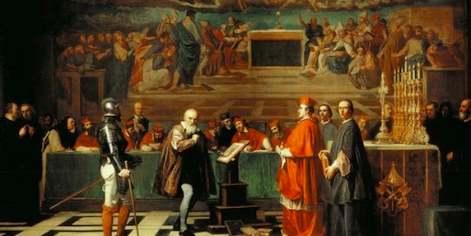
The Galileo Affair Short Course: May 24 – June 14 2018
Dr Kristian Camilleri
Enquiries: Caterina Sciacca, Community Education Manager, Faculty of Arts, Email: caterina.sciacca.edu.au • Tel: 03 83443996

