Slide 1
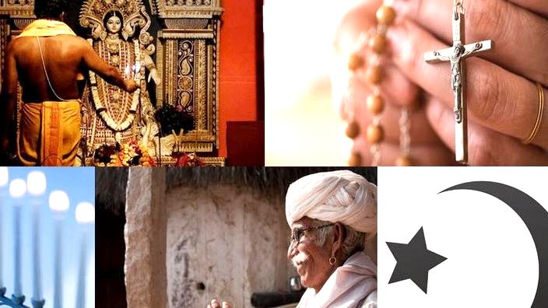
AOS 1.3 Religion in Australia
Workshop Intentions
Look at the Christian - Catholic Perspective
Unpack the study guide
Key theme - Challenge to Social Structure in Australia
Key knowledge and skills
Refer to some Resources
Some possible activities

Slide 2
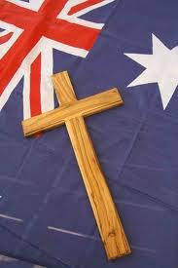
Study Guide
Religions in Australia
Past and Present - so a historical perspective
Influences on Australian Religious Composition
Secularisation
Migration
Self perception of each religion
Cohesive or Diverse?
Different forms of the tradition
Influence on the personal identity of adherents

Slide 3
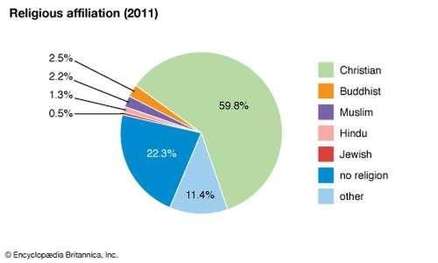
Key Knowledge
Distribution Past and Present of major religions in Australia
Influences of
Recent religious and non-religious trends
Government policy
on Australian Religious composition
Expressions of collective identity through relevant aspects of religion
Personal meaning and identity found through engagement with various and relevant aspects of religion
Tensions that occur within the tradition over issues of authority, freedom, interpretation of beliefs and teaching, behaviour
Interaction betweendifferent religious traditions and reasons for these
Role of religion in providing infrastructure/role of ecumenism

Slide 4
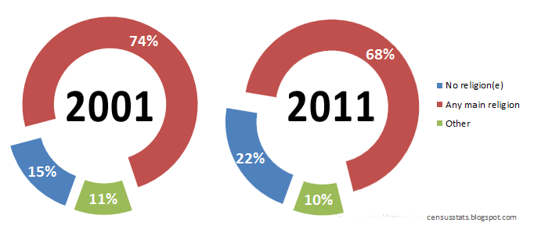
Key Skills
Describe DATA on
Distribution of
And adherence
to major religious traditions.
Explain influences on religious composition
Outline
how collective identity is expressed by religious traditions.
Personal meaning and identity that is found and further developed via engagement with aspects.
Describe tensions that can occur with members of the tradition.
Explain interactions between different traditions & wider society and reasons for these.
Interpret, Synthesise and Apply primary and secondary source material

Slide 5
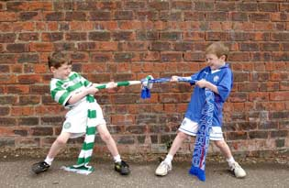
Key Themes - Sectarianism - Challenges within Christianity.
Sectarianism
Define
Find Instances/Examples in Australian Society past and present
Shift from Sectarianism between
Catholics/Protestants
Resource - Understanding Faith Unit 32
Activity - research family elders who were at religious schools until the 1970s

Slide 6
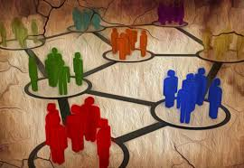
Key Themes - Origins of Australian Christianity - Challenge to Denominations Social Structures/Beliefs.
Catholic Perspective
Suppression of the Irish Catholics from 17th century
Attempt at an uprising by Irish Catholics 1798 in England
No priests in the colony until 1801 (as convicts)
First formal and accepted priest in 1820
Most Catholic convicts or new immigrants were quite irreligious
Anglican/Protestant Perspective
Saw the new colony as being “Anglican” only.

Slide 7
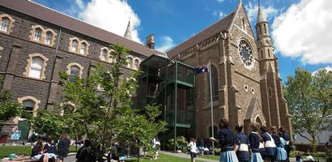
Key Themes - Challenges to Aspects around Education
Education Act of 1872/Catholic Response
ACT called for education to be free, compulsory and secular - this latter concept really challenged Catholics?
Catholic Response - Chose to fight the ACT
Key Aspects involved
Social Structure - Archbishop Goold
Beliefs - around the Kingdom and who was eligible?
Ethics - how ethical was the ACT as a decision that alienated religious groups.

Slide 8
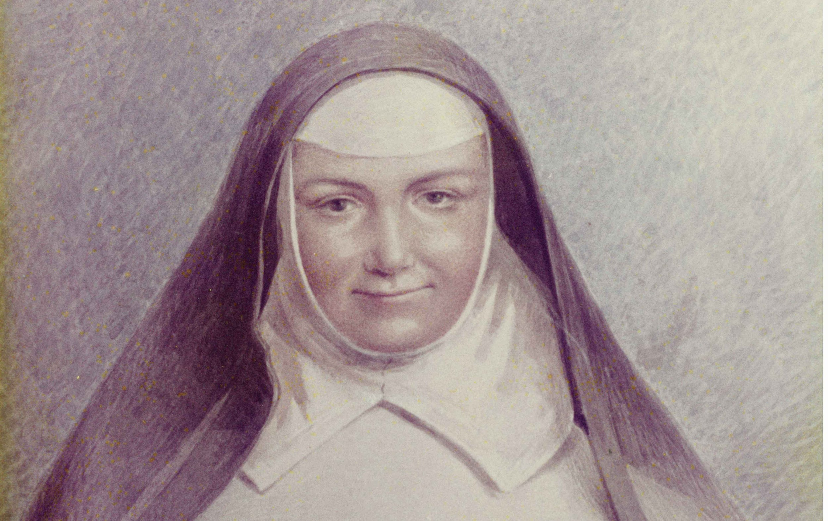
Key Themes - Challenges to Aspects around Education
Catholic Tertiary Institutions
Progress from Teachers’ Colleges to ACU
Catholic Education (a Social Structure) - Role of Religious Brothers, Nuns and Priests. How did this social structure survive? Sr Ursula Frayne RSM
Fight for State Aid (Ethics Issue - Denominational schools had to pay twice for education)
Goulburn strike 1961
You Tube Clip “Lilac Time in Goulburn”
Social structure - who decided?

Slide 9
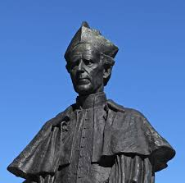
Key themes - Social Structure - Leadership/Authority
Key Leaders - Archbishops
Goold - Political
Mannix - Political
Knox - Structurally
George Pell - Education (Positive), Child Abuse (Negative)
Guildford Young - Built a “Catholic Identity in Tasmania”
Qualities
Patriarchal/Authoritarian?
Pastoral?
Political matters - DLP
Works of Bob Santa-Maria

Slide 10
Key themes - Leadership/Authority
Resources - Australian Catholic Bishops’ Conference web site
Documents (Texts) on Catholic approach to
Euthanasia
Child Abuse
Ecology/Climate
Marriage
Other Social Structures
Council of Vatican 2 - Australian Catholics were well informed and educated on changes especially
Liturgy
Role of Laity/role of religious and priests.

Slide 11
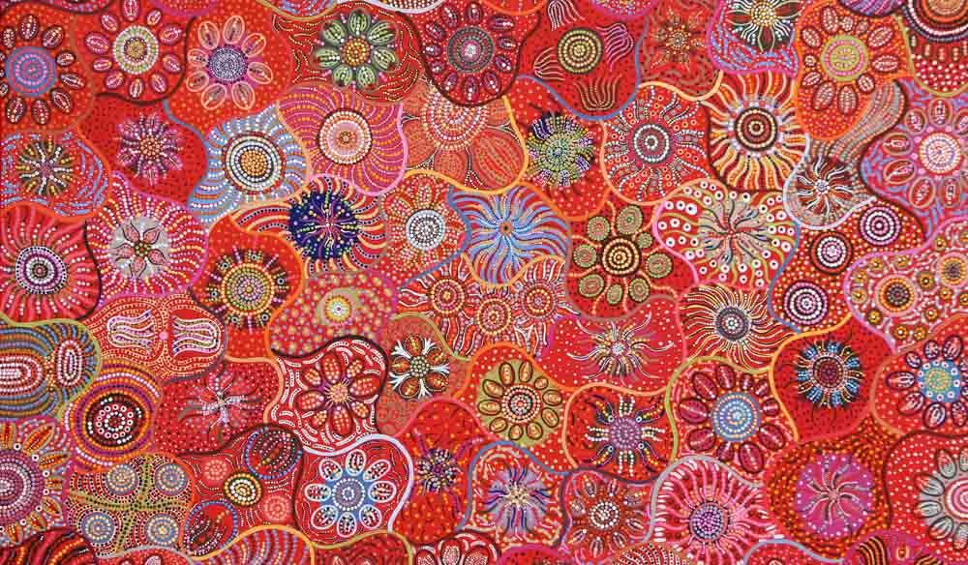
Key themes - Australian Soul - Secularism versus Religion & its Social Structures.
Definition of the Australian Soul
Good Resource - You Tube clip
The Making of Modern Australia Episode 04 'The Australian Soul'
Indigenous Aboriginal Spirituality
Influence on key Religions
How is this Spirituality enculturated into other Religions.
Australian sense of Justice
Research Outreaches such as:
Vinnies, Brotherhood, Smith Family etc

