Slide 1
Christianity: Challenges and Responses
RASNET conference, 14 March 2024
Joanna Cruickshank (Deakin University)

Slide 2
My areas of research
Historian of Christianity in Britain (18th century) and the British Empire (19th and 20th centuries)
Researched the role of white women in/on Aboriginal missions in the 19th and 20th centuries
Worked on major history of Coranderrk mission (the Minutes of Evidence project)
Current projects include assisting with an oral history of Wathaurong Aboriginal Co-op, surveying attitudes to history in Australia and study of colonial church land grants.
Notes:
My interest in the questions we are thinking about tonight is very much driven by my study of the relationship between Christianity and European imperialism and between Christianity and Indigenous ways of being here and elsewhere. I am reading back into the early history of Christianity to understand what happened in these more recent contexts and the ongoing ways that they shape both Christian communities and the broader world..

Slide 3
Challenges for/to Christianity
What relationship will Christian individuals and institutions have to the dominant culture, its values and institutions? (accommodation, rejection, active engagement, withdrawal, critique, endorsement, acceptance, persecution)
How will they understand their place and time in the purposes of God (‘salvation history’ or ‘salvation geography’)? (as replacing Jewish people as ‘the chosen ones’, as ‘grafted on’ to Judaism, as national, imperial or global in identity, in the end times or at the beginning of something new)
How will internal differences and divisions be managed? (schism, union, reunion, by establishing authorities of creed (Orthodoxy), episcopacy (Roman Catholicism) or Scripture (Protestantism), through violence, through compromise, through tolerance).
Notes:
At different times and in different places, challenges in one of these three categories may emerge as particularly significant. For example, a major theological division may lead to major schism within the church. Or a particular church tradition may face intense persecution and be at risk of dying out altogether. However in general these three challenges are closely related and overlapping. For example, how churches understand their place in salvation history is likely to inform its relationship to the dominant culture, but in any given Christian tradition there are likely to be differences in how these relationships are understood.

Slide 4
Christianity and Slavery
- general historical background
- key shifts and points of difference
- resources to follow

Slide 5
What is meant by ‘slavery’?
In ‘Chattel’’ slavery, people are classed as property and can be bought and sold at will. Enslavement is often inherited.
In some societies, enslaved people were routinely incorporated into kin relationships over several generations.
Other forms of unfree labour, which include serfdom and indentured/bonded labour, are also forms of slavery
Forms of slavery have been practiced in many, probably most societies for the last 11000 years.
Slavery was both common and legal in the Jewish, Roman and Greek societies in which Christianity emerged.
Notes:
Indigenous societies here in these lands are some of the only peoples who do not seem to had slavery or enslaved people as part of their societies.

Slide 6
Early Christianity and Slavery
Slavery is a key metaphor within the Christian/New Testament texts, used with both positive and negative connotations. Jesus himself became a slave (Phil 2.7)
These texts assert the spiritual equality of ‘slave and free’ in Christ (Gal 3.28), but also assume that slaveholding is compatible with membership in the body of Christ (Eph 6.9; Col 1.2)
Both the NT writers and many early Christian authors:
Urge slave holders to be moderate and just in their treatment of enslaved people.
Condemn slave-traders and the trade in enslaved people
Allow or encourage manumission (the freeing of enslaved peoples)
Notes:
Jesus is described as voluntarily becoming a slave by becoming human, Christians are depicted as slaves of Christ, but this slavery is also depicted as freedom from slavery to sin. Slavery has both positive and negative connotations in the NT texts.
There is no evidence that Christians were more temperate or less violent towards enslaved people than their pagan neighbours.

Slide 7
Early Christianity and Slavery
‘Be slaves to one another, Jesus taught. The cultivation of humility and a slave-like ministry of mutual service were moral innovations characteristic of the Christian movement, innovations that did not result in systematic opposition to the institution or ethical critique of slaveholders.’
Glancy, ‘Slavery and the Rise of Christianity’
Notes:
Ultimately, most early Christian writers concluded that slavery was a consequence of human sinfulness after the Fall. It should be ameliorated but could not and did not need to be eliminated. This ‘slave tag’ dates from the period after Constantine.

Slide 8
Medieval Christianity and Slavery (476-c1500CE)
‘Although there exists a general belief that slavery gradually died out in Europe during the Middle Ages, slavery and slave markets existed in Christian Europe throughout this period. Italian merchants… were major figures in the trade.’
Muldoon, ‘Spiritual Freedom, Physical Slavery’
In Europe itself, chattel slavery was increasingly replaced by other forms of unfree labour (‘serfdom’) but some Europeans participated actively in selling and buying enslaved non-Christians (including Balkan and Muslim people).
Notes:
The image depicts Pope Gregory 1, in the late 6th century, noticing ‘Angles’ or English people, who were being sold in a slave market in Rome.

Slide 9
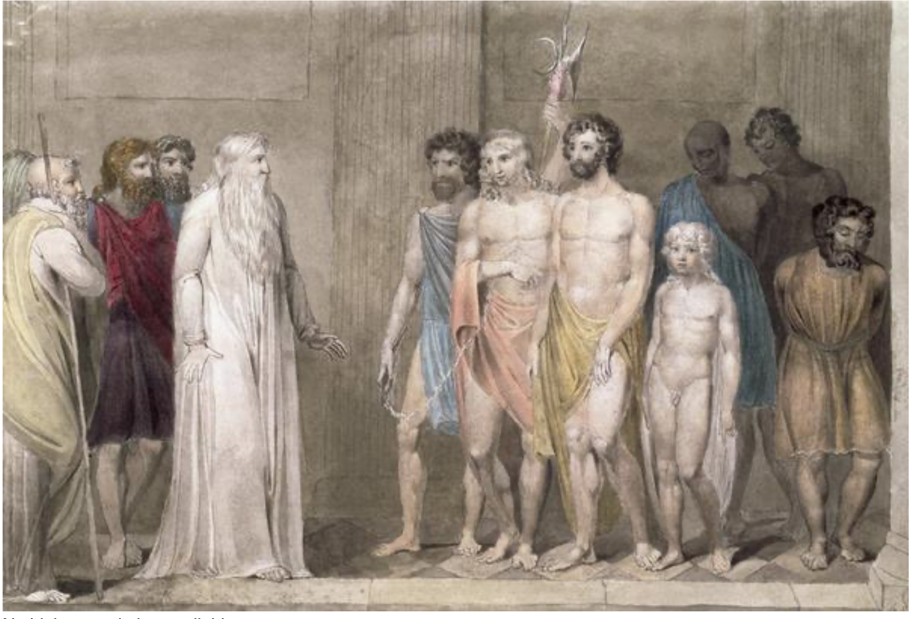
Medieval Christianity and Slavery
With the emergence of canon law during this period, slavery became the focus of legal reflection and codification:
Christians could not be taken as slaves under canon law
People who were baptized after being enslaved did not need to be released (though slaveholders were encouraged to do so)
Marriage between enslaved people was encouraged and legal; married couples could not be separated.
Pope Gregory I observes Angle (English) slaves at a slave market in Rome.
Notes:
As a consequence of these laws, many slaveholders tried to keep enslaved people unbaptized and unmarried.

Slide 10
Slavery and European Empires
It was in the context of imperial expansion that European powers – first the Iberian empires and then the French, British and Dutch – began to engage in enslavement on an historically unprecedented scale.
This included the enslavement of 2.5-5 million Indigenous people of the Americas and at least 12.5 million Africans.
This enslavement and trade in human beings was foundational to the power that these Christian empires developed and for much of this period it was either endorsed or accepted by the dominant European Christian traditions.

Slide 11
Atlantic Slave Trade in 2 minutes

Slide 12
Catholic Empires
In the mid-15th century, several papal bulls endorsed the enslavement of Muslims and other non-Christian peoples. When the Iberian empires began colonizing the Americas after 1492, these were extended to approve enslaving the indigenous people of these lands.
Bartolome de las Casas, a Spanish missionary, argued powerfully for an end to the system of slavery.
In 1542, this led to Spanish laws against slavery in 1542, which in turn led to a revolt by colonial landholders in Peru.

Slide 13
Catholic Empires
The expansion of the enslavement and trade of Africans leads to the emergence of race as a concept and the racialization of slavery
Some Catholic leaders protested the arrival of enslaved Africans to Catholic colonies, but these voices were largely over-ridden by economic interests.
Spanish (as of 1538), Portuguese, and French (1685) legal systems required that all slaves be baptized and instructed in religion.

Slide 14
Protestant Empires
Enslaved people were the foundation of the economy of the British Empire via the Caribbean colonies and the American colonies.
In the Caribbean slave plantations and then in the – forms of slavery developed which were perhaps uniquely oppressive.
In the southern states, enslaved people were completely removed from kin networks, unable to legally marry and liable to separated from children and partners at any moment
Opportunities for manumission were increasingly limited – enslaved people faced endless generational enslavement
Slavery is completely racialised

Slide 15
Abolition
The movement for the abolition of slavery was primarily a religious movement, fueled by the Protestant Evangelical Revival, but building on older currents including Quaker and Catholic traditions of anti-slavery.
This movement included the voices and experiences of enslaved peoples, many of them Christians, though often mediated through white abolitionists.

Slide 16
Abolition
Regardless of the underlying motivations for slavery and its abolition, the debate over abolition in the British Empire and then in America was conducted in religious terms.
This included the development of comprehensive theological arguments for and against enslavement.
The American Civil War is a violent conflict over this theological question.

Slide 17
Abolition
Slavery is abolished in Britain in 1807, the British Empire in 1833
Reparations are paid to slaveholders, not enslaved people
Those empires and nations which still allow enslavement follow suit in abolishing slavery
In 1863, slavery is abolished in the US

Slide 18
Christianity and Slavery
How has slavery been a challenge to or for Christianity?
In many times and places slavery and Christianity have co-existed quite comfortably
Historically, many Christian individuals and states have gained power and wealth from the capture, trading and labour of enslaved peoples.
Within Christianity, there has been continuous theological reflection on enslavement and the treatment of enslaved people
There is a long tradition of minority voices questioning the institution of slavery itself.
At times, slavery has been the focus of profound divisions within Christianity, at time spilling into revolt and war among Christians

Slide 19
Christianity and Slavery
There is now a broad consensus that slavery is incompatible with Christianity, which is a result of the theological arguments constructed by enslaved people themselves, their descendants as well as other abolitionists.
This includes critiques of the theology of 18th-19th century abolitionists
The role of Christianity in the horrors of racialized slavery can be identified a challenge to the moral legitimacy of the faith.

Slide 20
Resources
Glancy J. ‘Slavery and the rise of Christianity’ in Bradley K, Cartledge P, eds. The Cambridge World History of Slavery. Cambridge University Press; 2011:456-481.
Muldoon, J. ‘Spiritual freedom, physical slavery: the medieval church and slavery’. Ave Maria Law Review, 3:1 (2005), 69-94.
Servant or Slave? (Documentary) 2015. https://www.screenaustralia.gov.au/the-screen-guide/t/servant-or-slave-2015/33088/
Slate Magazine, ‘The Atlantic Slave Trade in 2 Minutes’, https://slate.com/news-and-politics/2021/09/atlantic-slave-trade-history-animated-interactive.html

