Slide 1
Ethics in Christian and Jewish Traditions
Dr. Scott A. Kirkland, Trinity College, Melbourne. scottk@trinity.edu.au

Slide 2
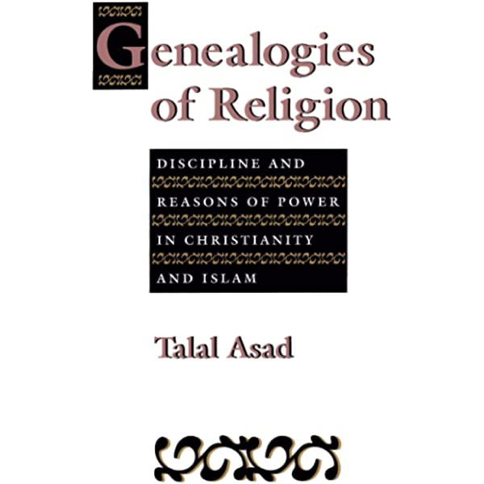
The Situation in the Scholarship
Talal Asad, Geneaologies of Religion (John Hopkins University Press, 1993).
Tomoko Masuzawa, The Invention of World Religions (Chicago University Press, 2008).
The object of study often now is diffuse, and strays into arenas not intuitively associated with “ethics” in our vernacular.
Challenging the universality and neutrality of the secular, scholars have begun approaching religion using a variety of methodological tools: literature, philosophy, material culture, economy, etc.
While “religion” might not be a stable object as it once was, religion is a vibrant and diffuse area of study overlapping with the full gamut of human concerns, the very shape/form of human life.

Slide 3
Part 1: OrIgins

Slide 4
Christian and Jewish Origins: Entanglement
Christians did not initially identify as such, but rather were from various Jewish traditions who identified Jesus of Nazareth as the messiah.
The subsequent inclusion of the Gentiles (a term for non-Jewish others) was the ground of contention in earliest Jesus traditions. See, Adi Ophir and Ishay Rosen Zvi, Goy: Israel’s Multiple others and the Birth of the Gentile (Oxford University Press, 2018).
Paul’s use of the language of “gentile” (ethnoi) is somewhat novel in Jewish traditions.
The earliest disputes are over ethnic inclusion that has to do with the inheritance of covenant promises, and so the “boundary markers” are circumcision, dietary restrictions, etc.

Slide 5
Christian and Jewish Origins: Entanglement
Earliest Christian and Jewish communities often followed models of association common in the ancient world. Synagogue and Ekklesia being names for other general forms of assembly.
These followed the pattern of guilds, trade organisations, religious cults, or other social clubs, formations, etc. See John Kloppenborg, Christ’s Associations: Connecting and Belonging in the Ancient City (Yale University Press, 2019).

Slide 6
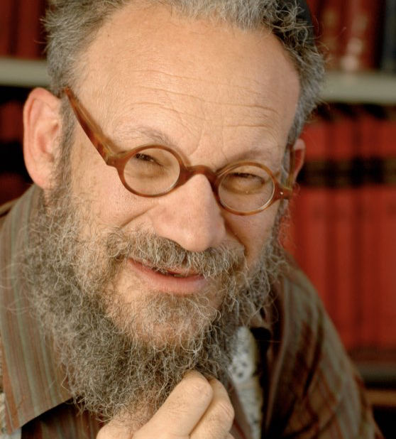
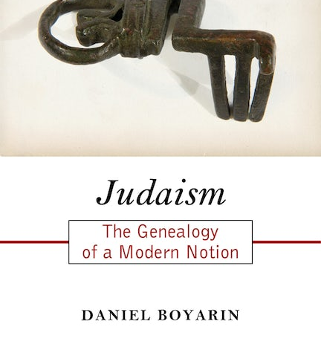
Daniel Boyarin: Judaism
“…the notion that there is a “religion” called “Judaism”—or better put, an Ekklesia (Synagoga) called “Judaism”—… is a product of Christian semantic necessity and production, not that of Jews.” Daniel Boyarin, Judaism : The Genealogy of a Modern Notion (Rutgers University Press, 2018).

Slide 7
Similarities
“What is hateful to you, do not unto others.” Hillel the Elder (late 1st C)
“Whatever you hate to have done to you, do not do to your neighbour…” Rabbi Akiva (late 1st C)
“Jesus replied: ‘Love the Lord your God with all your heart and with all your soul and with all your mind.’ This is the first commandment. And the second is like it, ’Love your neighbour as youself.’ All the law and the prophets hang on these two commandments.” Gospel of Matthew (late 1st C)
”all the commandments are summed up in this word, ‘Love your neighbour as yourself.’ Love does no wrong to a neighbour, therefore, love is the fulfilment of the law.” Apostle Paul (late 1st C)

Slide 8
Part 2: Development of Traditions of Moral Debate

Slide 9
Sources of Authority: Canons of Scripture (Jewish)
Canon derives from the Greek meaning “measuring” or “ruling stick”
The Rabbis speak of “inside” and “outside” books.
Christian councils right up until the 16th C are deliberating upon canonicity.
“Authoritative scriptures” can be more useful language to use prior to the first century, where Josephus (Jewish historian) lists a canon of 22 books. 4 Ezra lists 24 books. This evidence suggests something of a canon of Hebrew Scriptures in the first century.

Slide 10
Sources of Authority: Canons of Scripture (Christian)
Christian scriptures begin to circulate from about 45CE with the writing of Paul’s Epistle to the Galatians.
Other oral and written traditions circulate (Q, “quelle”, material) and are consolidated in the forms of the gospel narratives.
In the second century this material begins to be firmed up in its use by authorities in the communities.
Tradition: tradere, to hand over. Citation produces authority, produces tradition, produces debate.

Slide 11
Development of Traditions: Pre-Medieval
Through Rabbinic tradition the Pirkei Avot [Ethics of the Fathers] is produced. A text which details principals of ethical life derived from debate over the interpretation of Torah (law), and its transmission.
Jewish tradition speaks of Halakah (debate over law), and Aggadah (non legal exegesis, sometimes homiletic).
Christian traditions engage in similar forms of reflection on the moral precepts of Jesus and the apostles, often refracting Hebrew traditions through those. See, for instance, Gregory of Nyssa’s The Life of Moses. These often take the form of sermons, or moral tracts following in the manner of ancient Roman and/or Greek authorities. So we see a synthesis of hebrew and ancient philosophical traditions in Christianity.

Slide 12
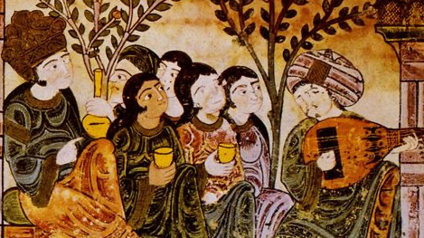
Medieval Traditions
The emergence of Islam from the 7-8th Century.
Translation movement (12th C) and the encounter with Aristotle in the Latin West. Encounter with virtue traditions.

Slide 13
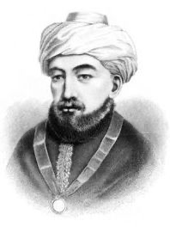
Medieval Jewish Tradition
Important again to remember the encounter with Islam, particularly live in Iberia. Lives with us linguistically and culturally. Think, paella, use of saffron, or El-/Al- (as in El-Dorado)
Maimonides offers an interpretation of Aristotle, and in turn influences Thomas Aquinas.

Slide 14
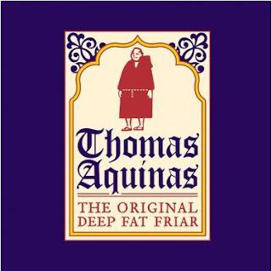
Christian Medieval Traditions
Virtue (arete) in Aristotle hinges on the development of habit (hexis) directing us toward our proper end (telos).
Theological virtues are developed in the chief Christian thinker of the middle ages, St. Thomas Aquinas. These include prudence, justice, temperance, courage.
Conterminously a natural law tradition begins to develop, in which nature is ordered toward the good, but requires the aid of grace. This develops a tradition stemming from Augustine of Hippo (5th C)
“Goodness and being are really the same.” Summa Theologica Ia 5.3.

Slide 15
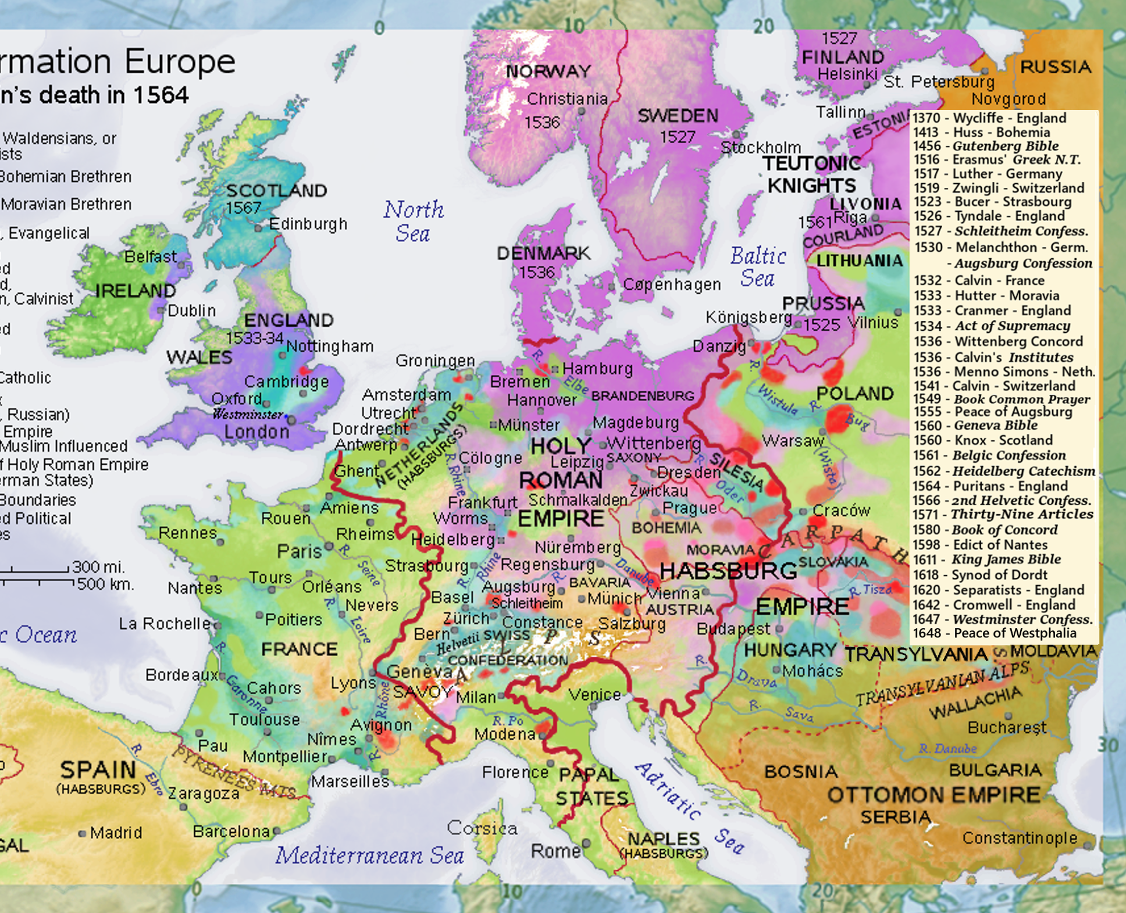
Threshold of Modernity
The reformation in Europe and the breakup of Empire
Emergence of nationalism which is continually a problem for Jewish populations
“The book of the world is written in mathematical script.” Galilleo. The relativization of latin, of natural law traditions, and the entrace of “history” as a category organizing philosophy and theology.
The displacement of forms of authority.

Slide 16
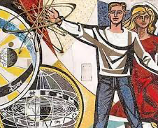
Part 3: Modern Theological and Philosophical traditions

Slide 17
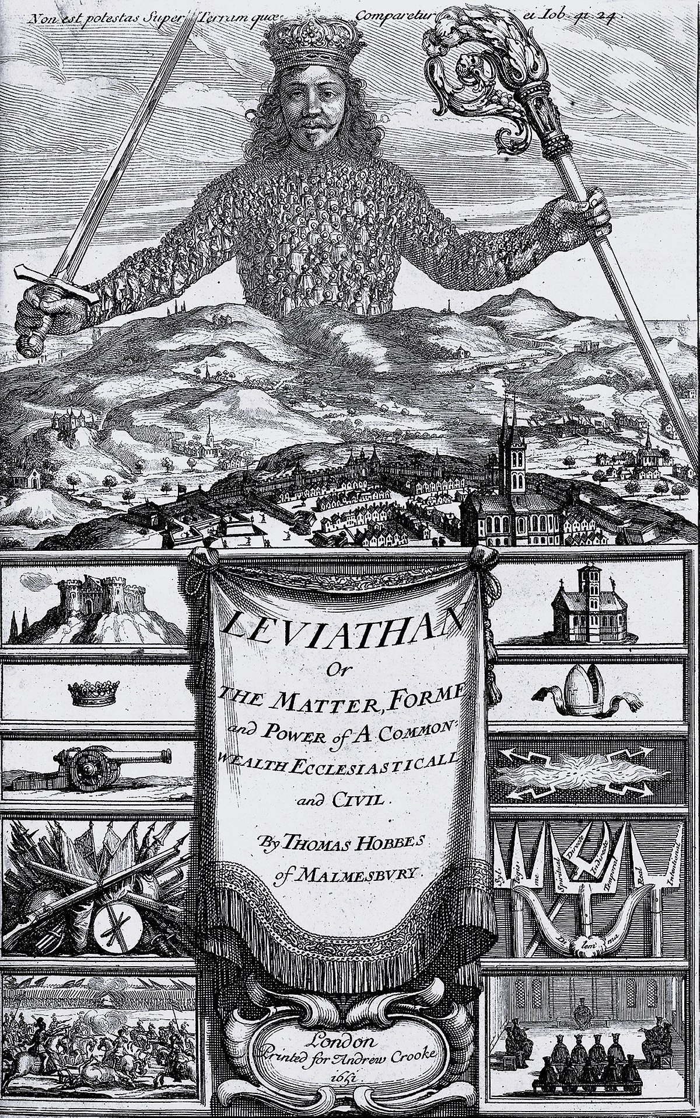
Duty
Immanuel Kant derives ethics from duty, from the categorical imperative. “Act according to that maxim whereby you can at the same time will that it should become a universal law.”
This maxim is understood by Kant to be the ground of autonomy.
This has roots in older forms of ethics in Thomas Aquinas. The “instrumental cause”, effective in the office of the priest, but generalizable in the problem of “offices”.
The problem of duty extends to the problem of obedience in Nazi Germany. The Eichmannian defense. “I was just obeying orders.”

Slide 18
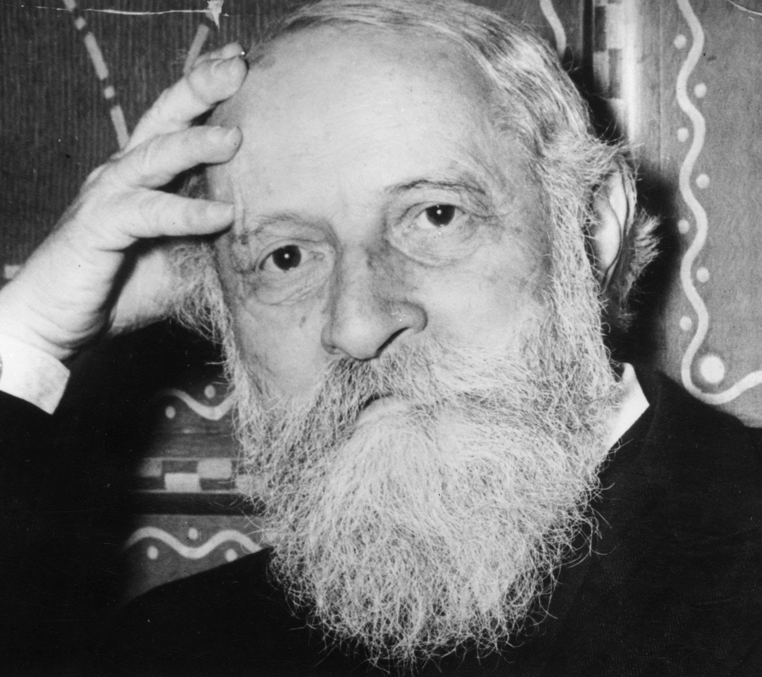
Contra-Kant: I-Thou
20th C Jewish philosophy contains an emphasis on alterity, otherness, and obligation.
Obligations are not sought through inner moral law, but in the concrete obligation to the other.
Examples of this include Martin Buber’s I-Thou, Emmanuel Levinas’ Totality and Infinity, or Hans Joas work.
This tradition is in dynamic engagement with non-Jewish philosophical traditions, particularly Kant and Martin Heidegger.

Slide 19
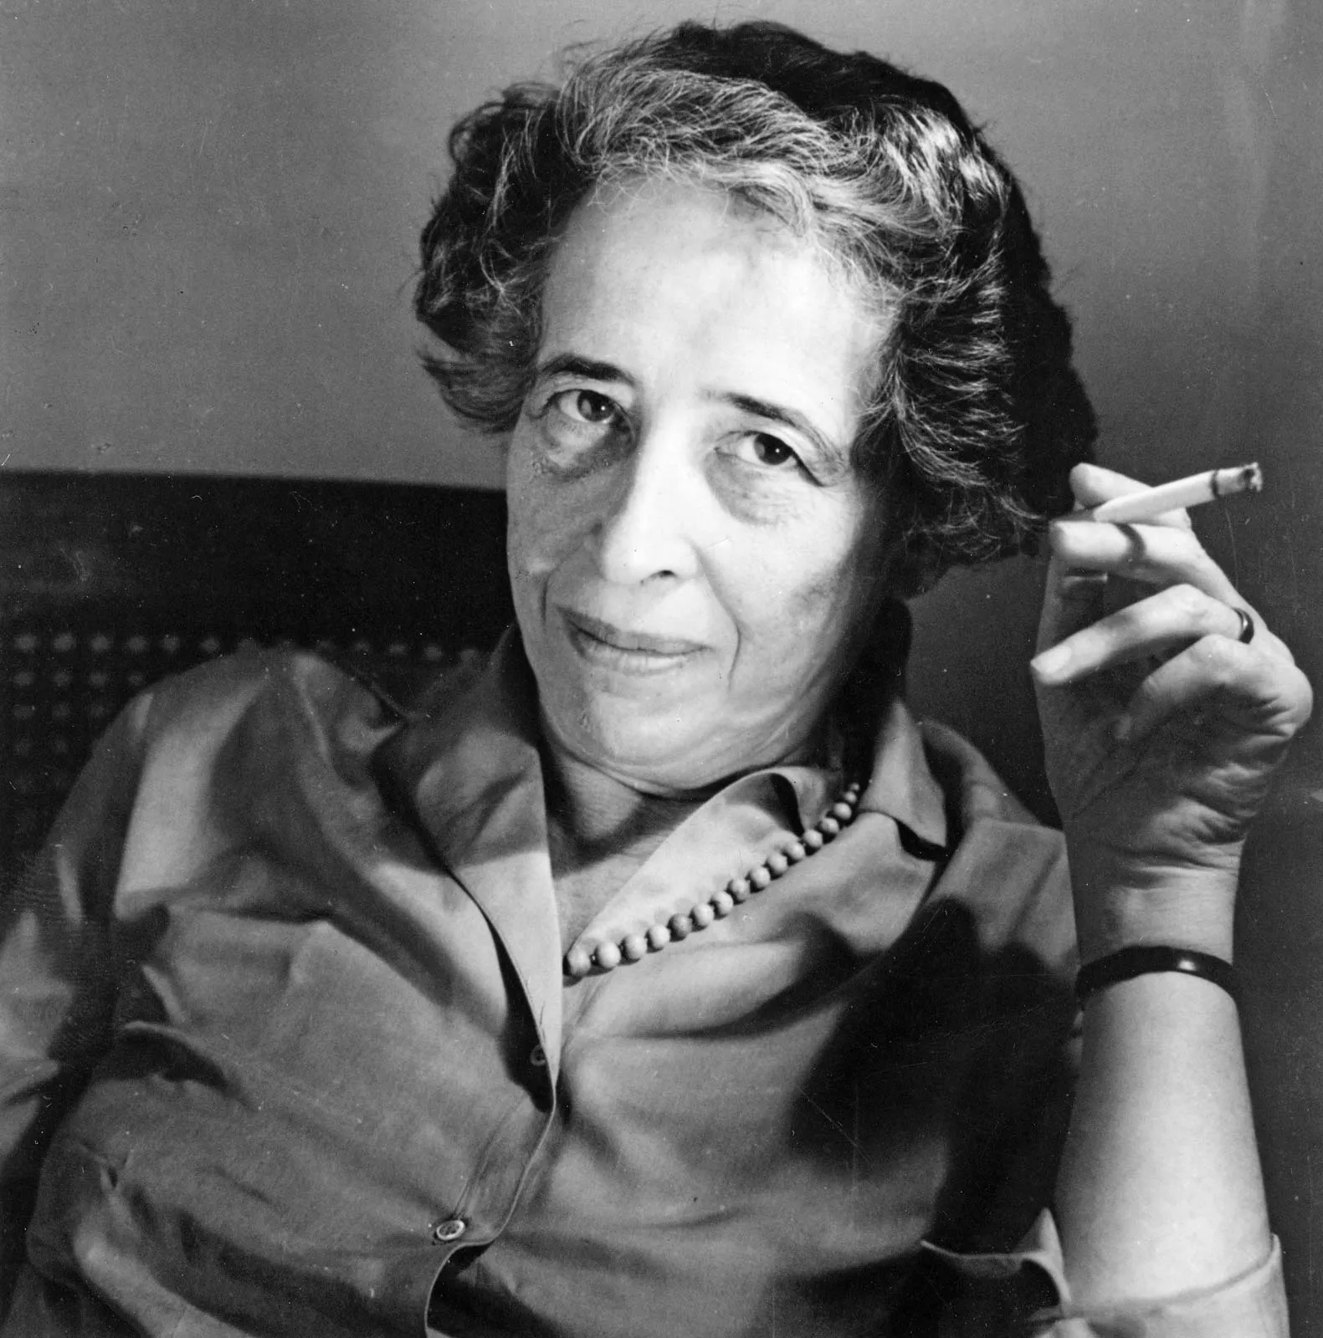
The Shadow of modernity
Hannah Arendt: “Justice is a matter of judgement.” Eichmann in Jerusalem (Viking Press, 1965).
“The trouble with Eichmann was precisely that so many were like him, and that the many were neither perverted nor sadistic, that they were, and still are, terribly and terrifyingly normal.”
Arendt’s controversial text raises the problem of the absence of thought, and so the absence of judgement under conditions in which one is ordered to act.
Moral consciousness becomes then, an obligation to think.

Slide 20
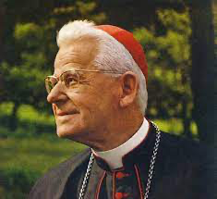
The shadow of modernity
Catholic Social Teaching and the “preferential option for the poor.”
The emergence of post-colonial nation states and the involvement of figures of liberation in struggle, e.g., Oscar Romero.
The obligation to see, judge, and act (Cardinal Joseph Cardijn), an exercise of the intellectual virtue of prudence.

Slide 21
Conclusion
Christianity and Judaism now consist of a plurality of traditions.
Plurality is constitutive of these traditions, and has been there all along.
Hannah Arendt, “Plurality is the human condition such that each human being is human precisely insofar as they are not identical with anyone who has existed, exists, or will exist.” If this is the ground of moral action, then, it is deeply bound up with what Arendt calls “sharing the earth.” The “refusal to share the earth”, the accusation made against Eichmann, is the supreme moral failing.

Slide 22
Bibliography
Asad, Talal. Genealogies of Religion (John Hopkins University Press, 1993).
Boyarin, Daniel. Judaism: The Genealogy of a Modern Notion (Rutgers University Press, 2018).
Buber, Martin. I and Thou (Continuum, 2004).
Kloppenborg, John. Christ’s Associations: Connecting and Belonging in the Ancient City (Yale University Press, 2019).
Levinas, Emmanuel., Totality and Infinity: An Essay on Exteriority (Kluwer Academic Publishers, 1991).
Ethics and Ininity (Duquense University Press, 2009).
Long, D. Stephen. Christian Ethics: A Very Short Introduction (Oxford University Press, 2010).
Lovin, Robin. An Introduction to Christian Ethics: Goals, Duties, and Virtues (Abingdon Press, 2011).
Newman, Louis. An Introduction to Jewish Ethics (Routledge, 2003).
Masuzawa, Tomoko. The Invention of World Religions (Chicago University Press, 2008).
Ophir, Adi, and Rosen-Zvi, Isahy. Goy: Israel’s Multiple others and the Birth of the Gentile (Oxford University Press, 2018).
Eds. Pirke Avot: A Modern Commentary on Jewish Ethics (Behrman House, 1999).

